Slide 1

CSE312 Electronic Design Automation
Presented to : Dr. Eman El Mandouh Supervised by : Eng. Kareem Wasiem
Verilog Lint – EDA design tool

Slide 2

Presented by
Team 13

Slide 3
01
02
03
Utility Functions
Violations Checking Functions
Generated Report
Outlines

Slide 4
Utility Functions
01

Slide 5
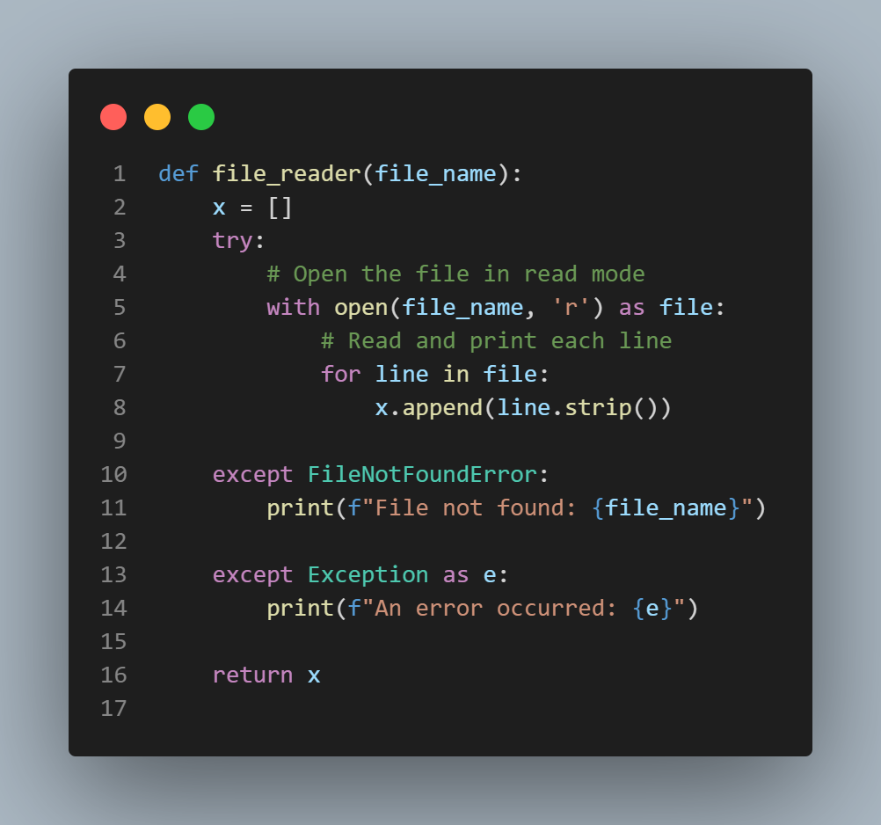
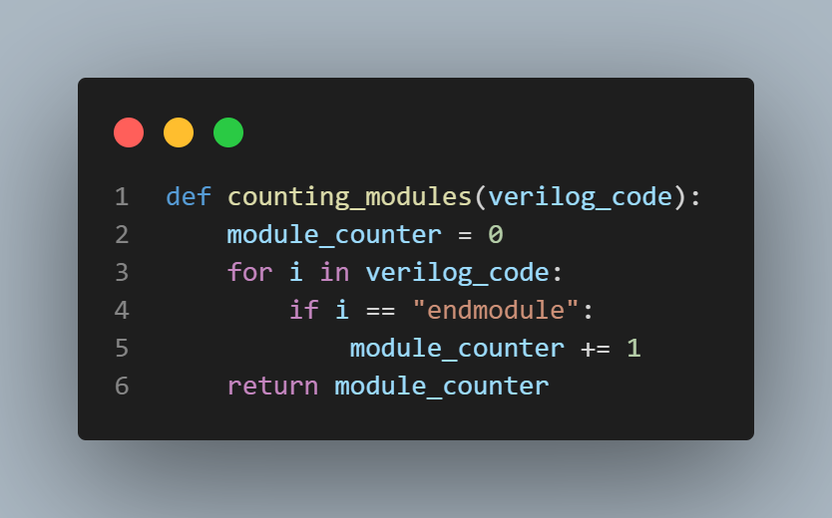
Function to read the DUT
Function to count number of modules in the DUT

Slide 6
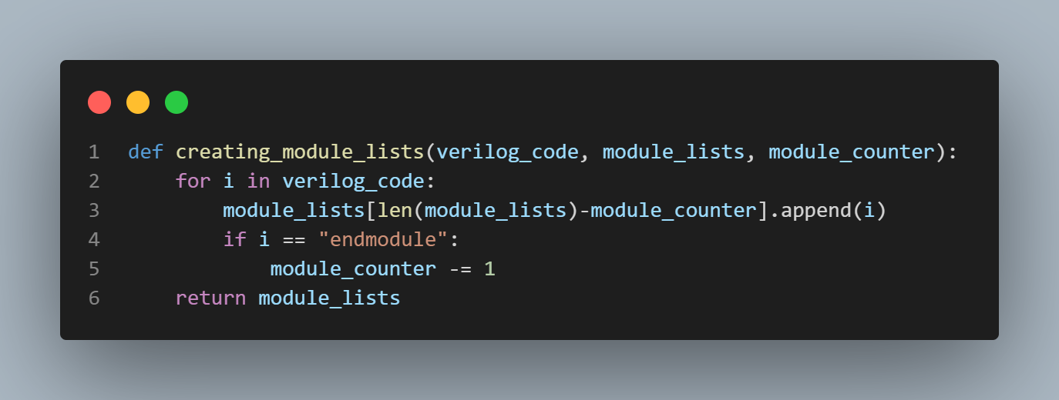
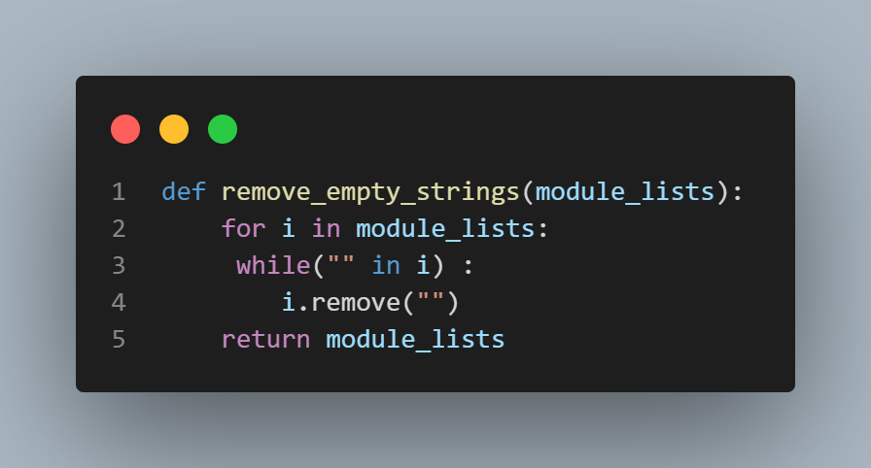
Function that extracts modules from the DUT and place them in nested lists
Function that deletes empty strings from nested lists that contains the modules

Slide 7
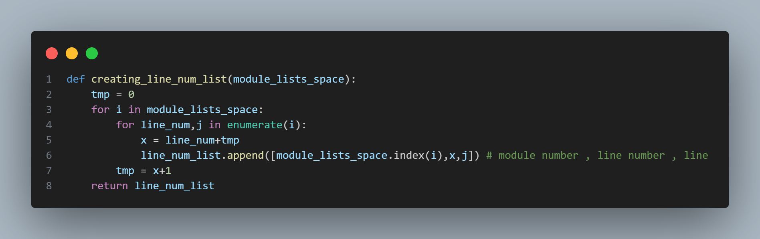
Function that handles line number

Slide 8
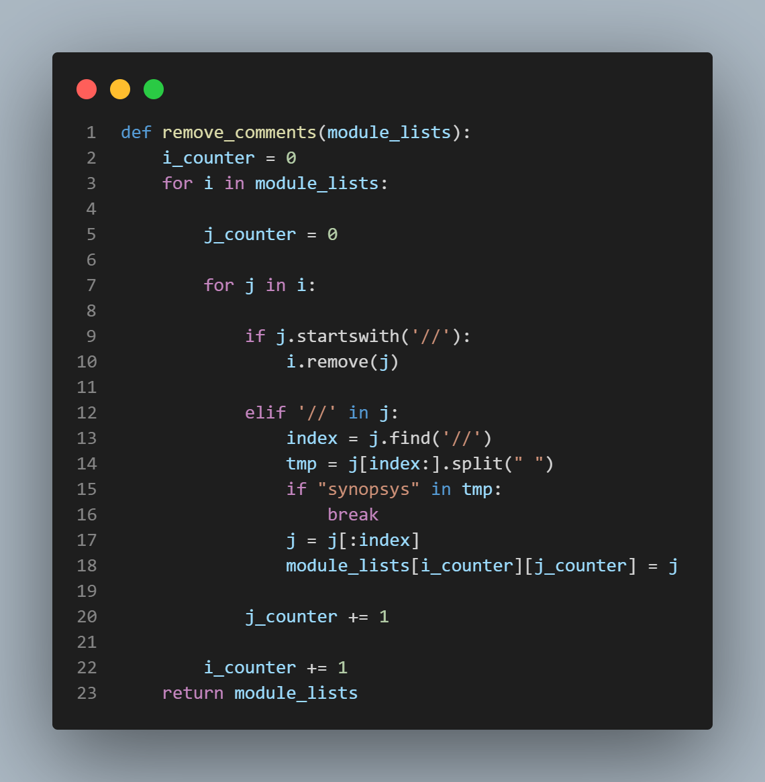
Function that remove comments from Nested Lists containing modules Considering Synopsys Exceptions

Slide 9
Violations Checking Functions
02

Slide 10
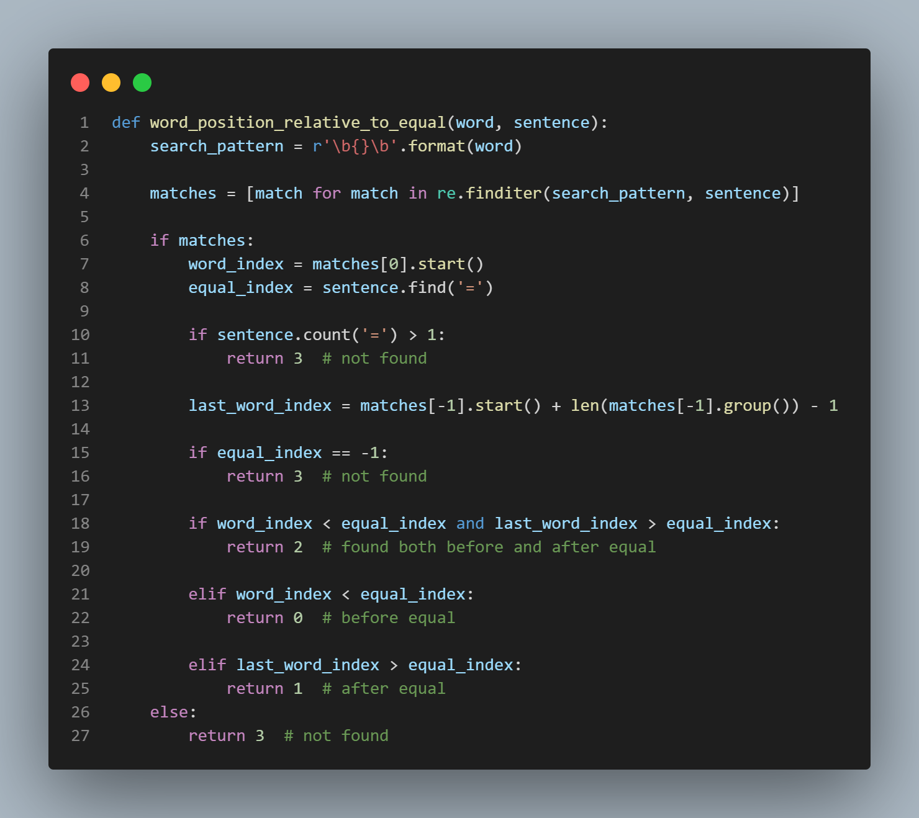
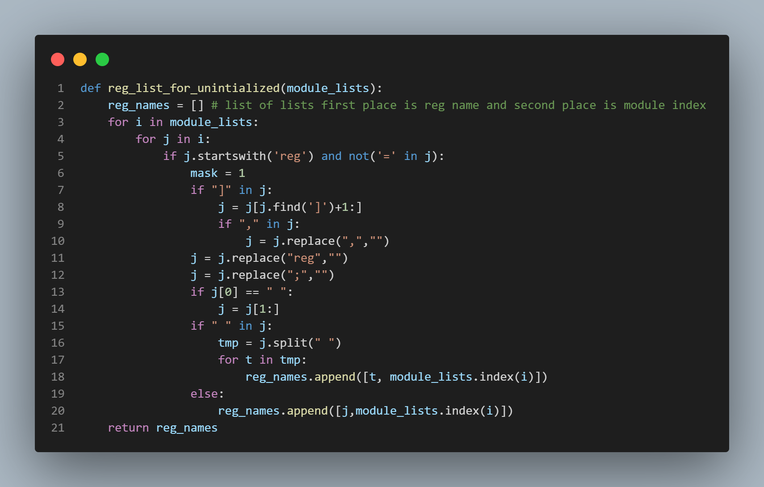
Uninitialized register

Slide 11
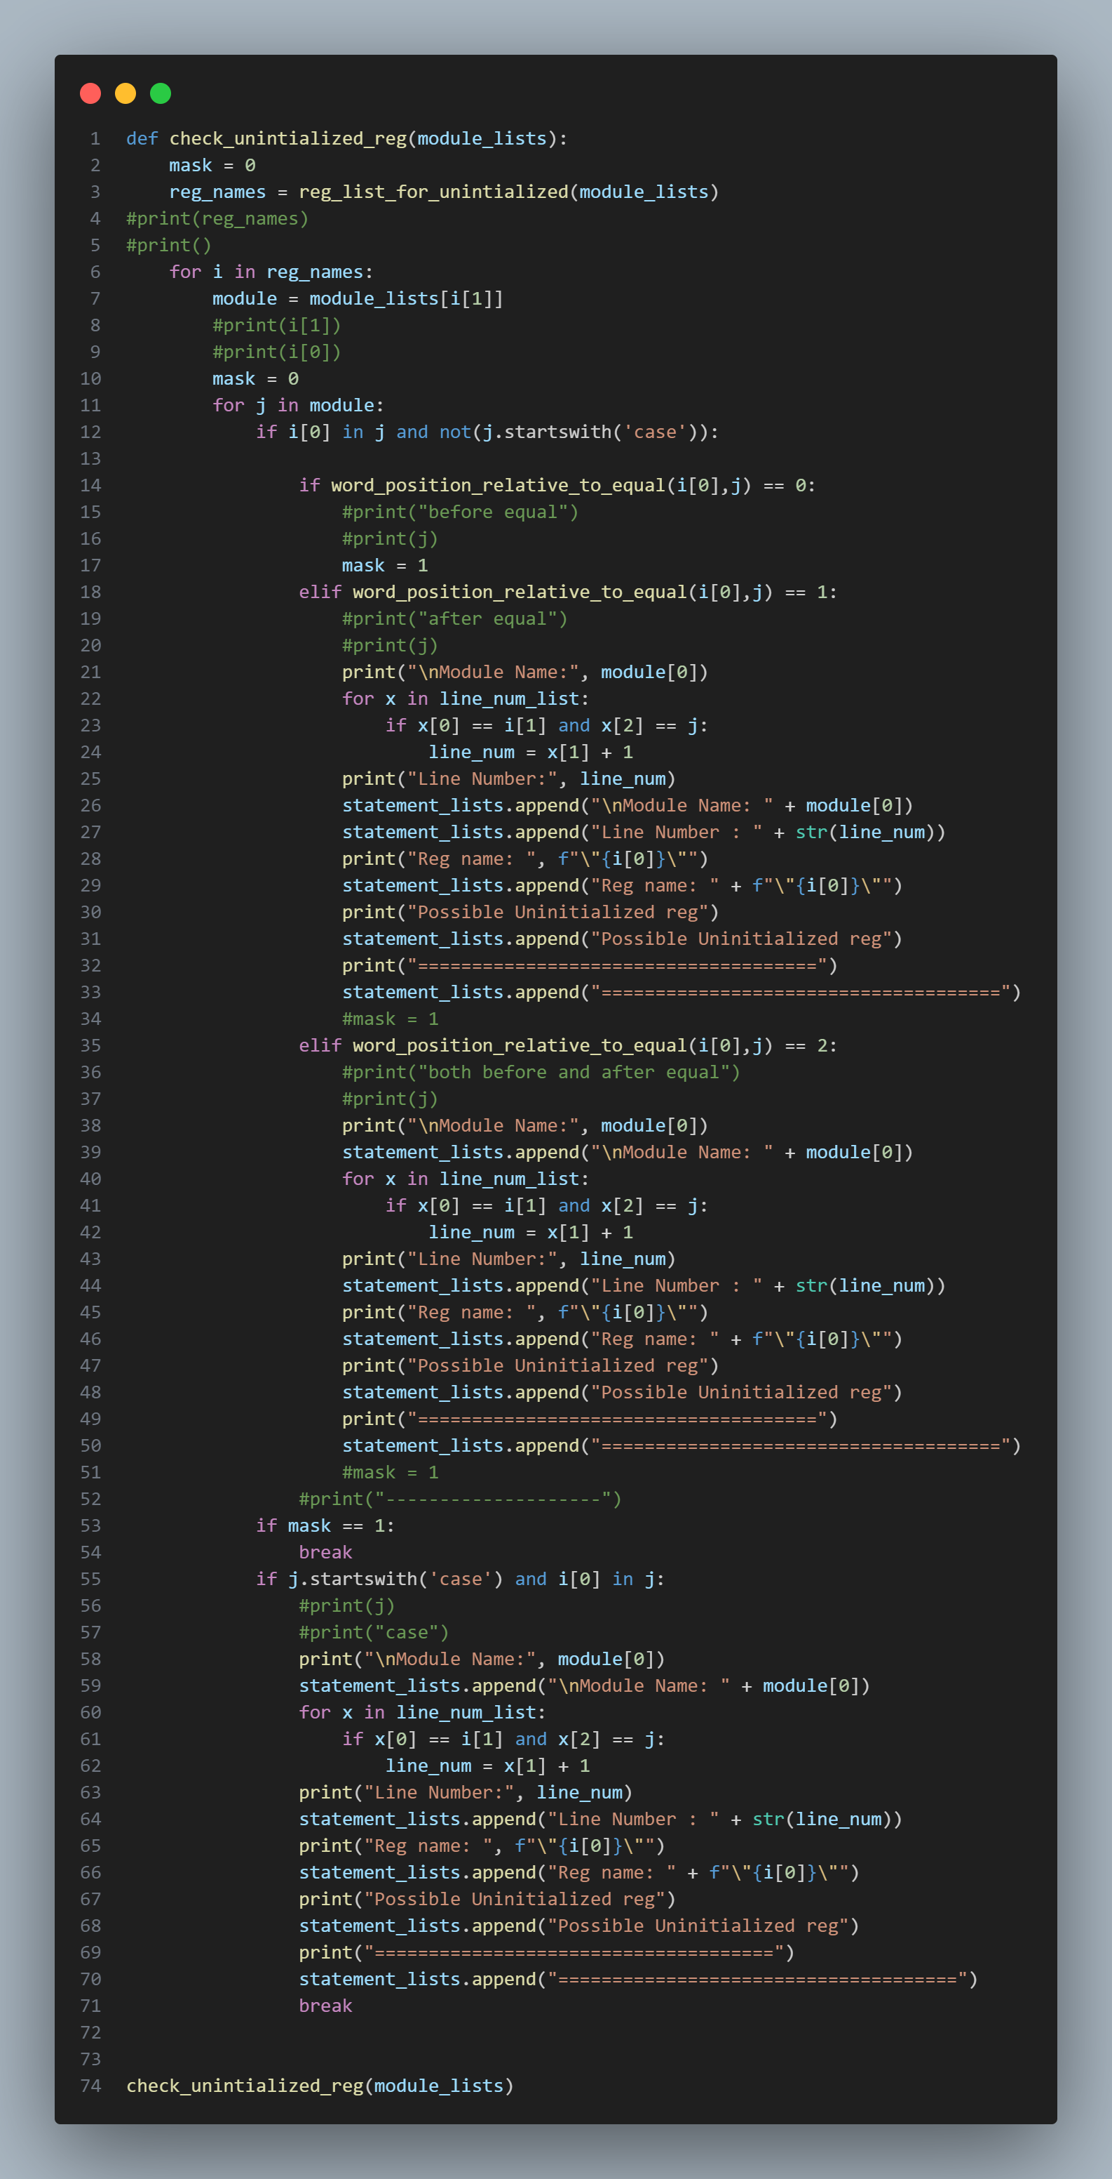

Slide 12
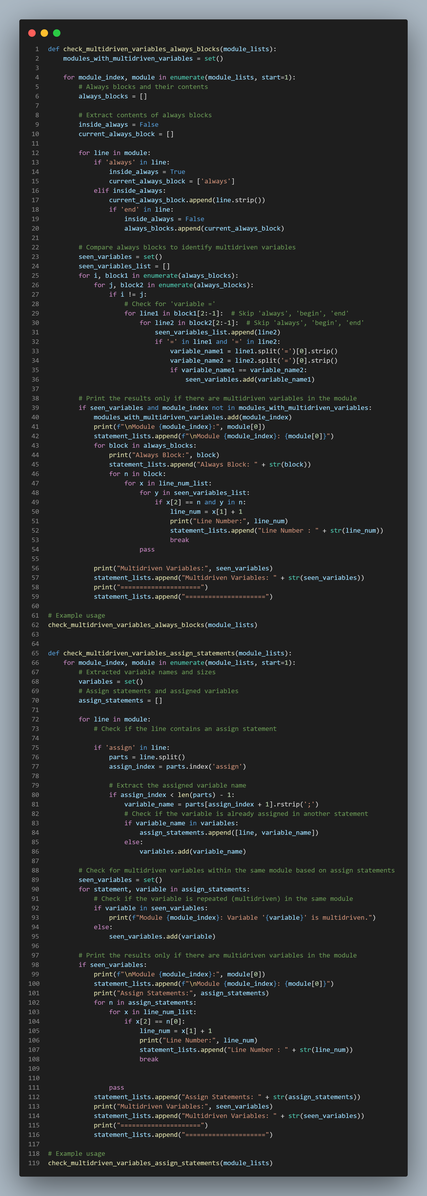
Multiple Drivers

Slide 13
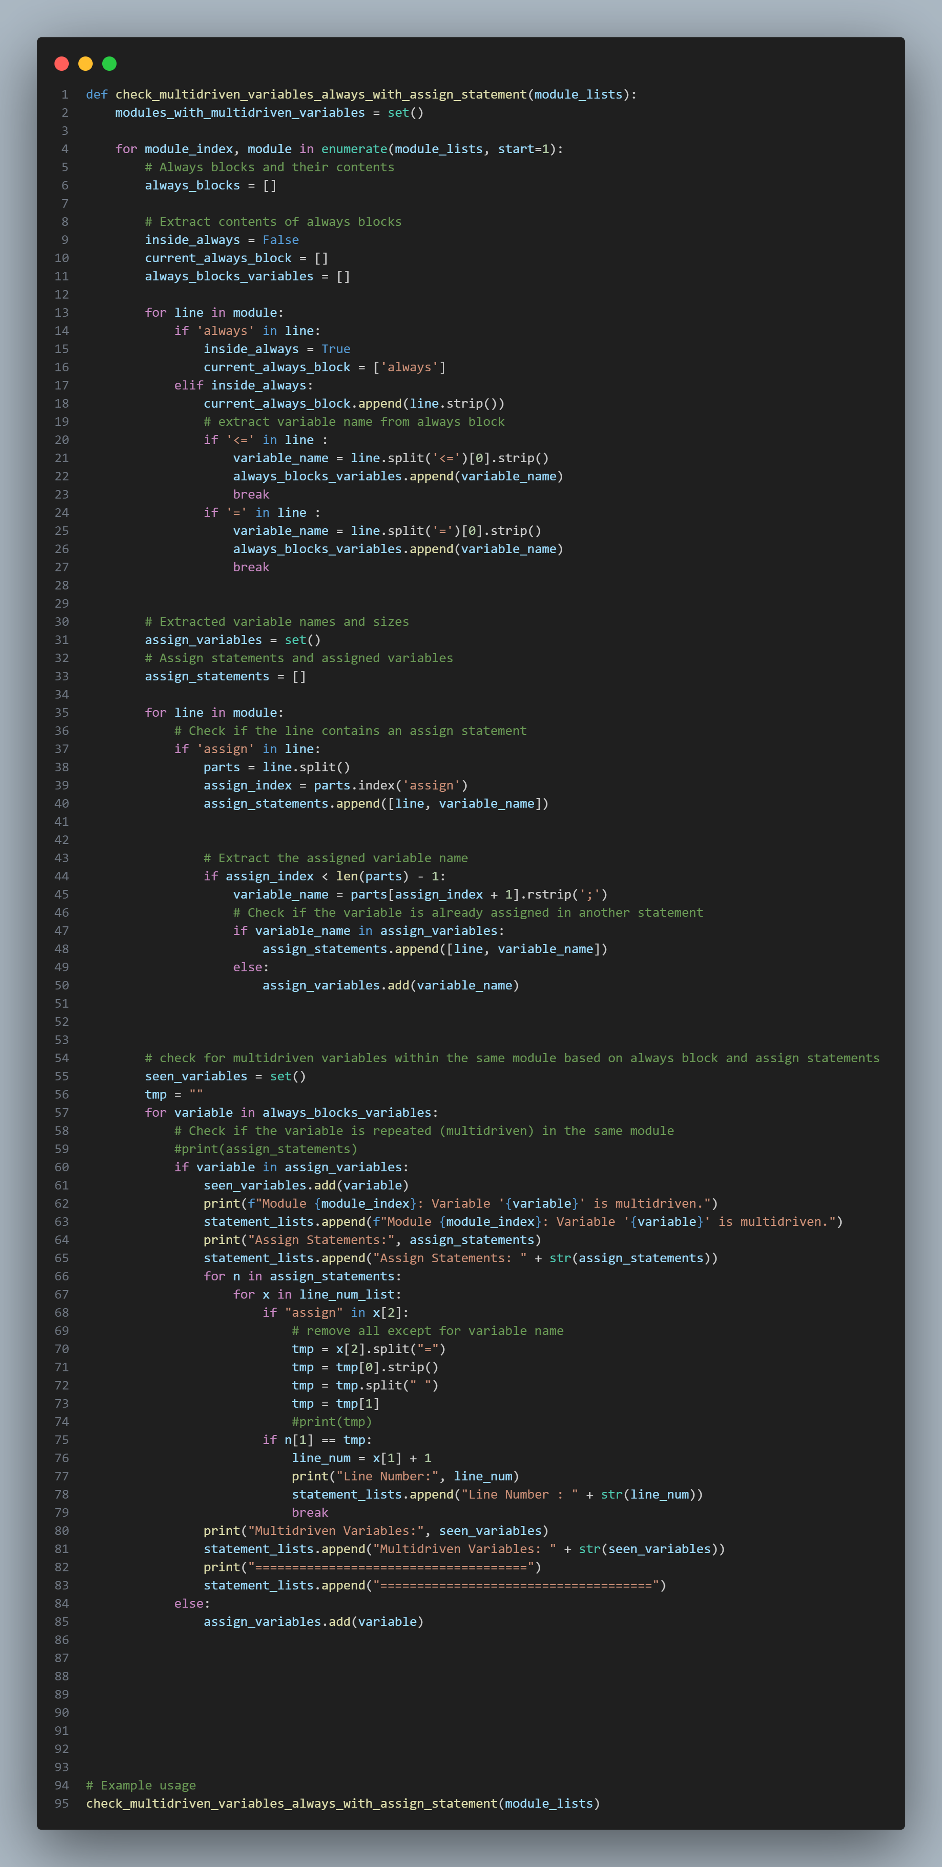
Multiple Drivers

Slide 14
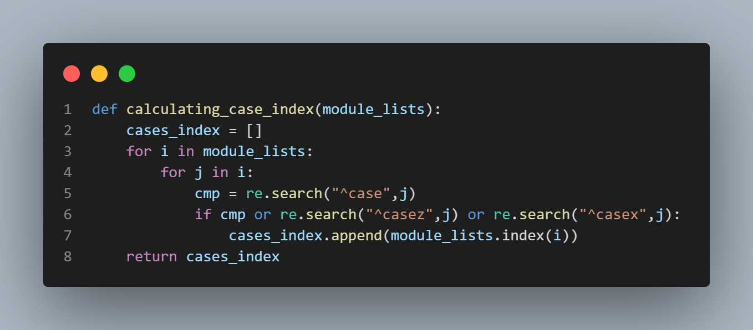
Non-Full/Parallel Case
1- Non-Full Case checker

Slide 15
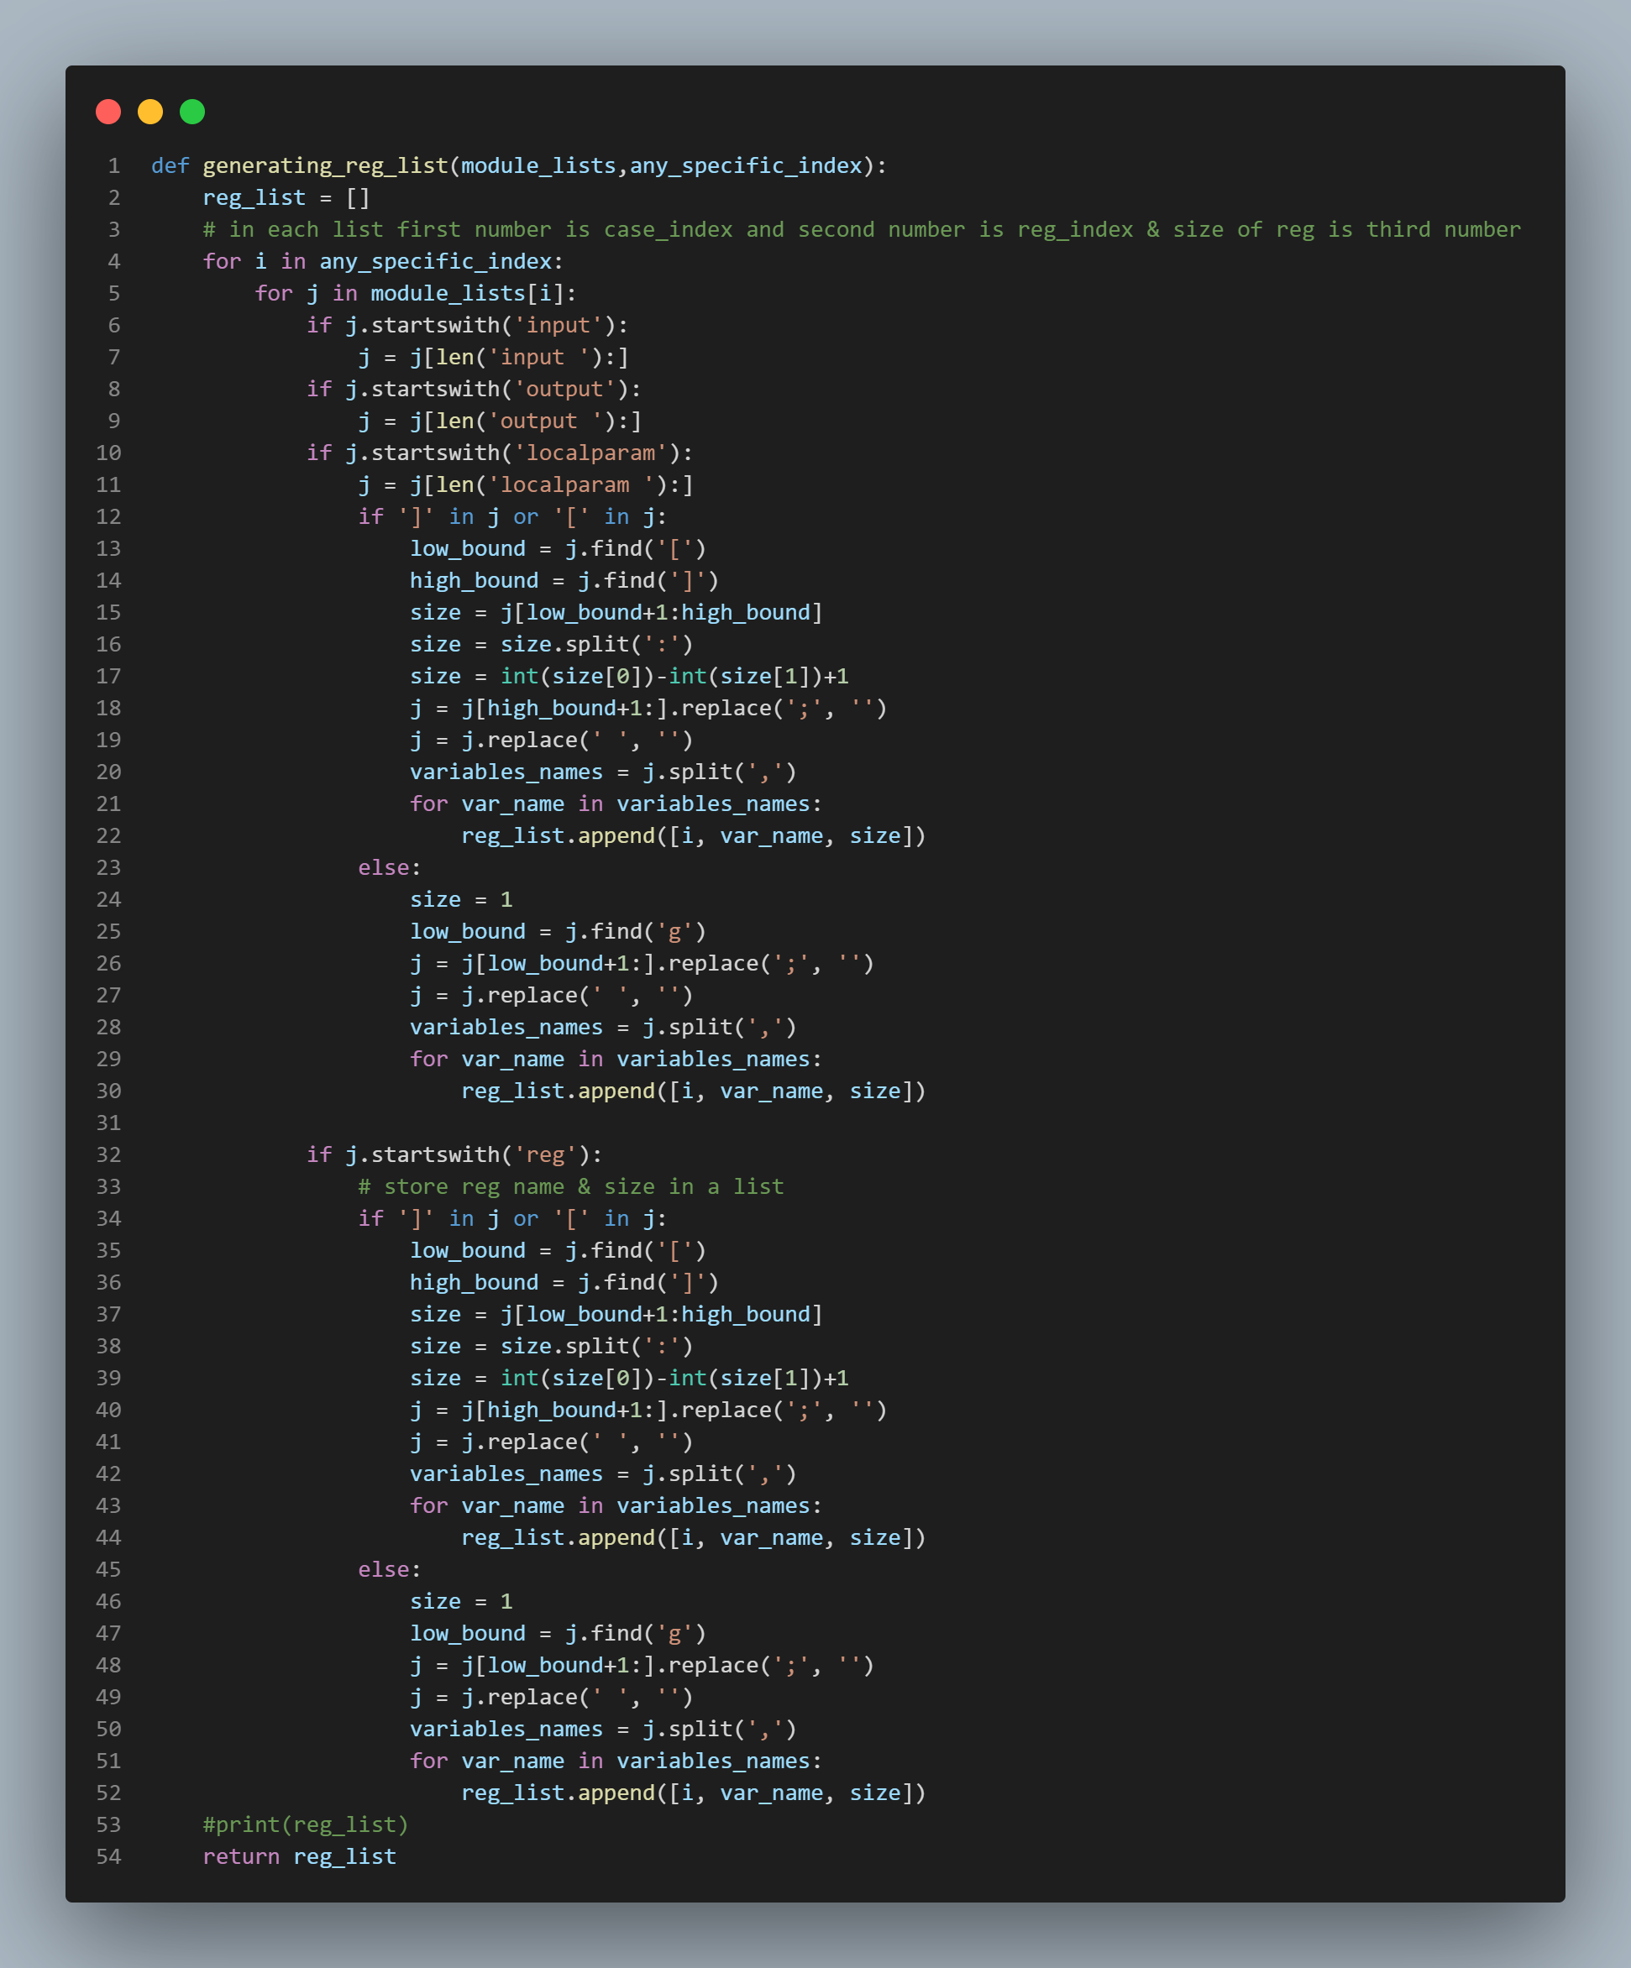
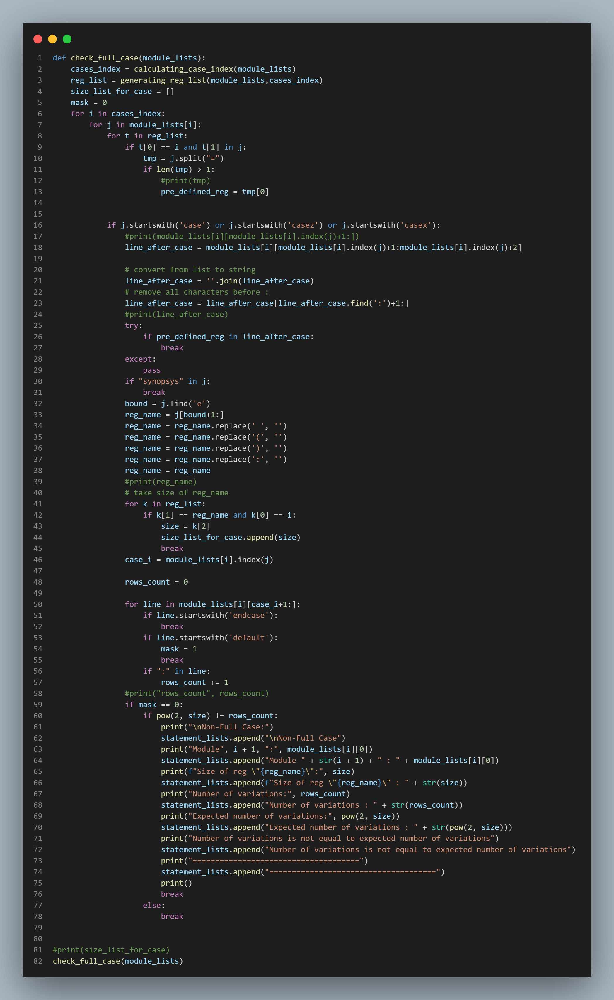

Slide 16
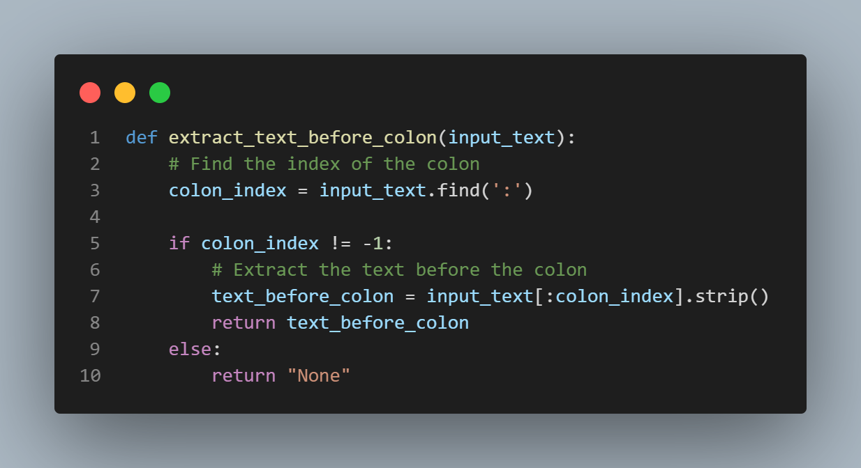
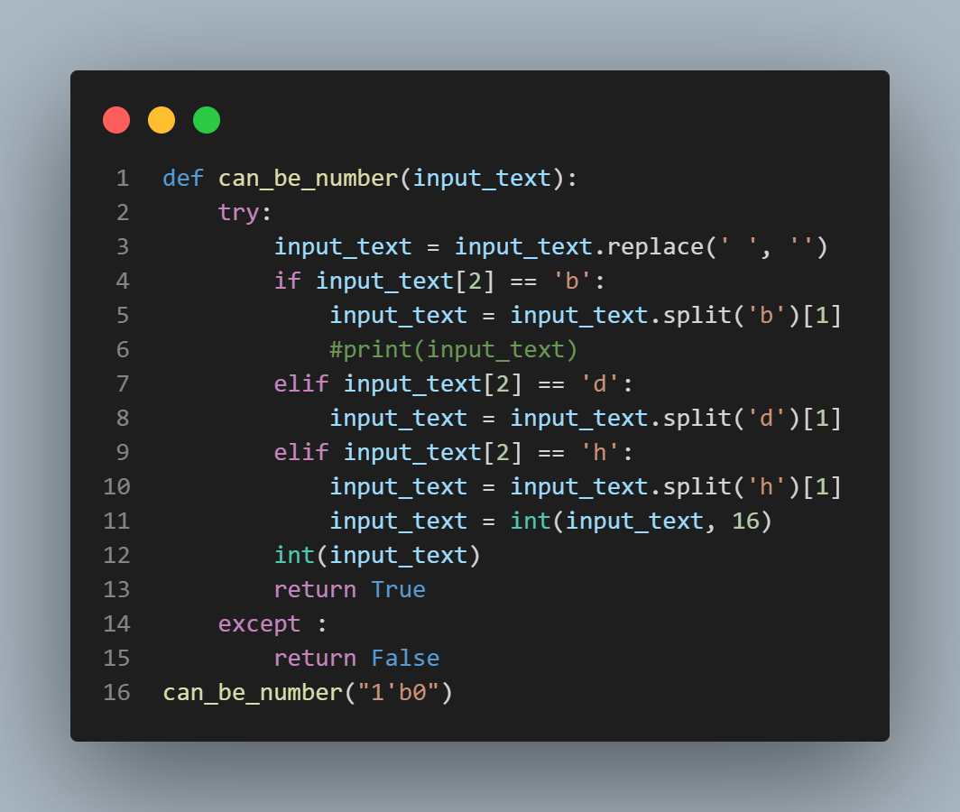
2- Non-Parallel Case checker

Slide 17
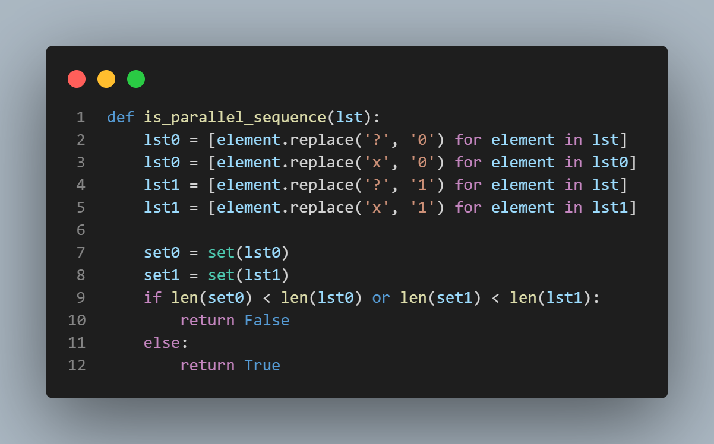

Slide 18
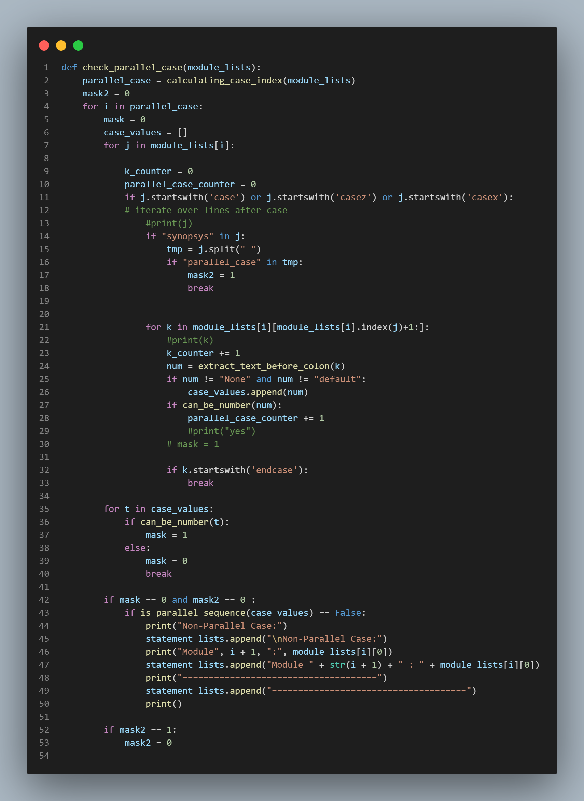

Slide 19
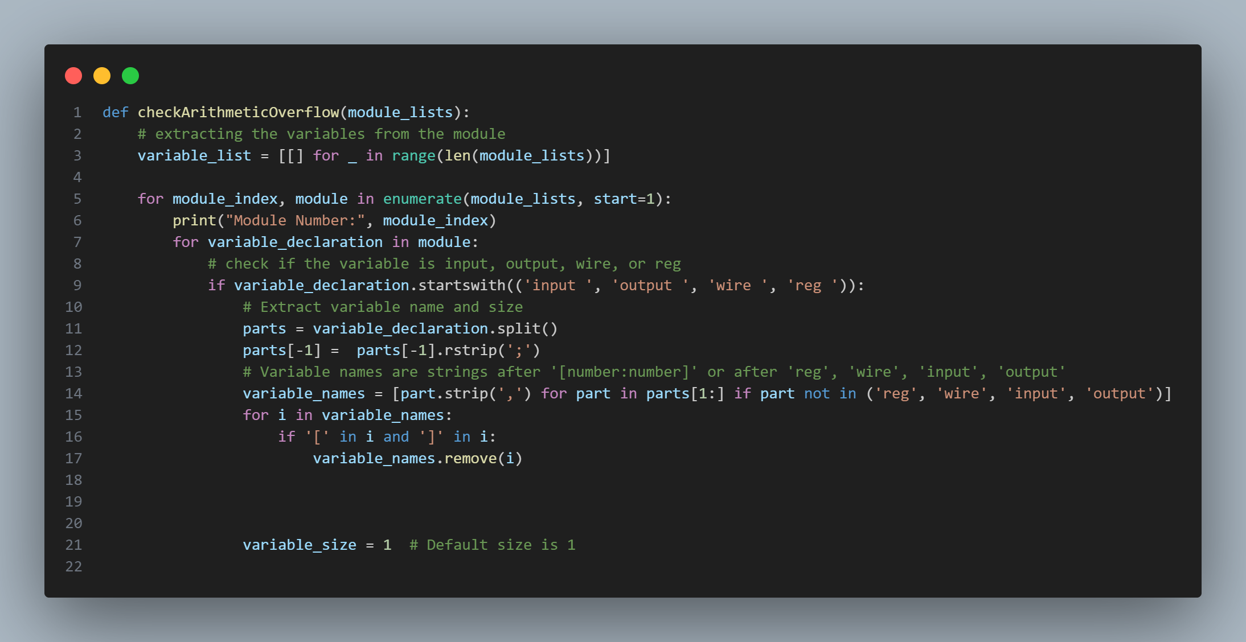
3- Arithmetic Overflow

Slide 20
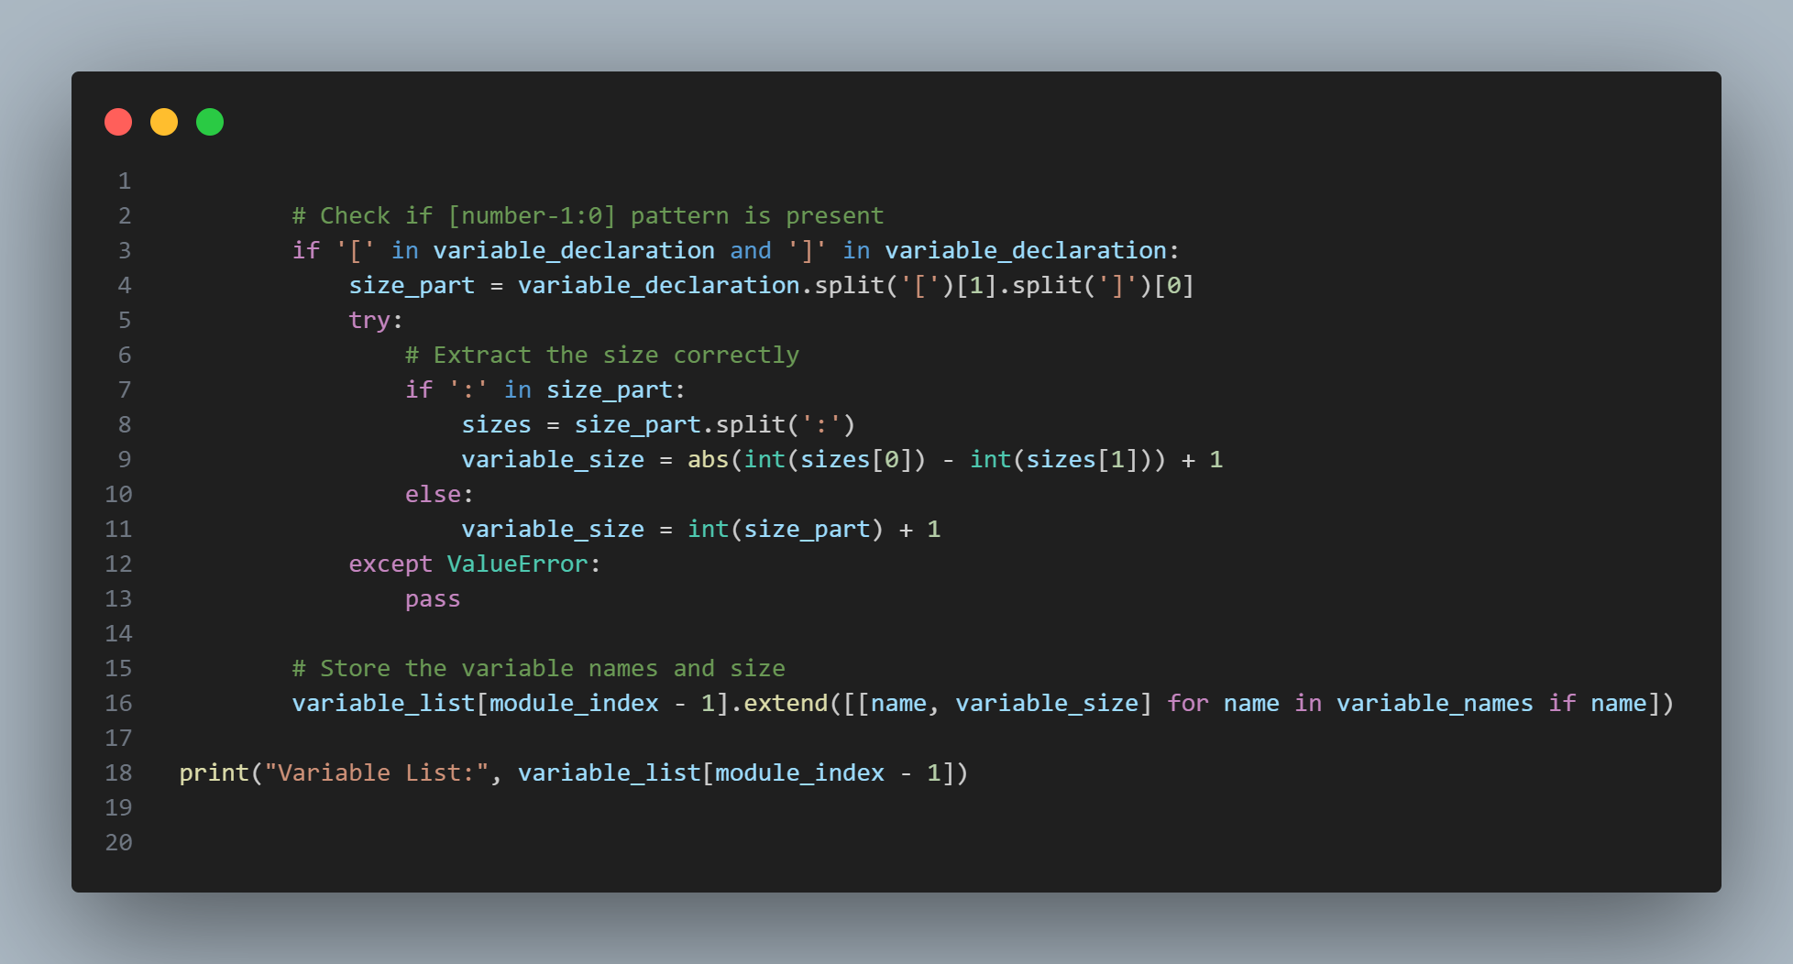
3- Arithmetic Overflow

Slide 21
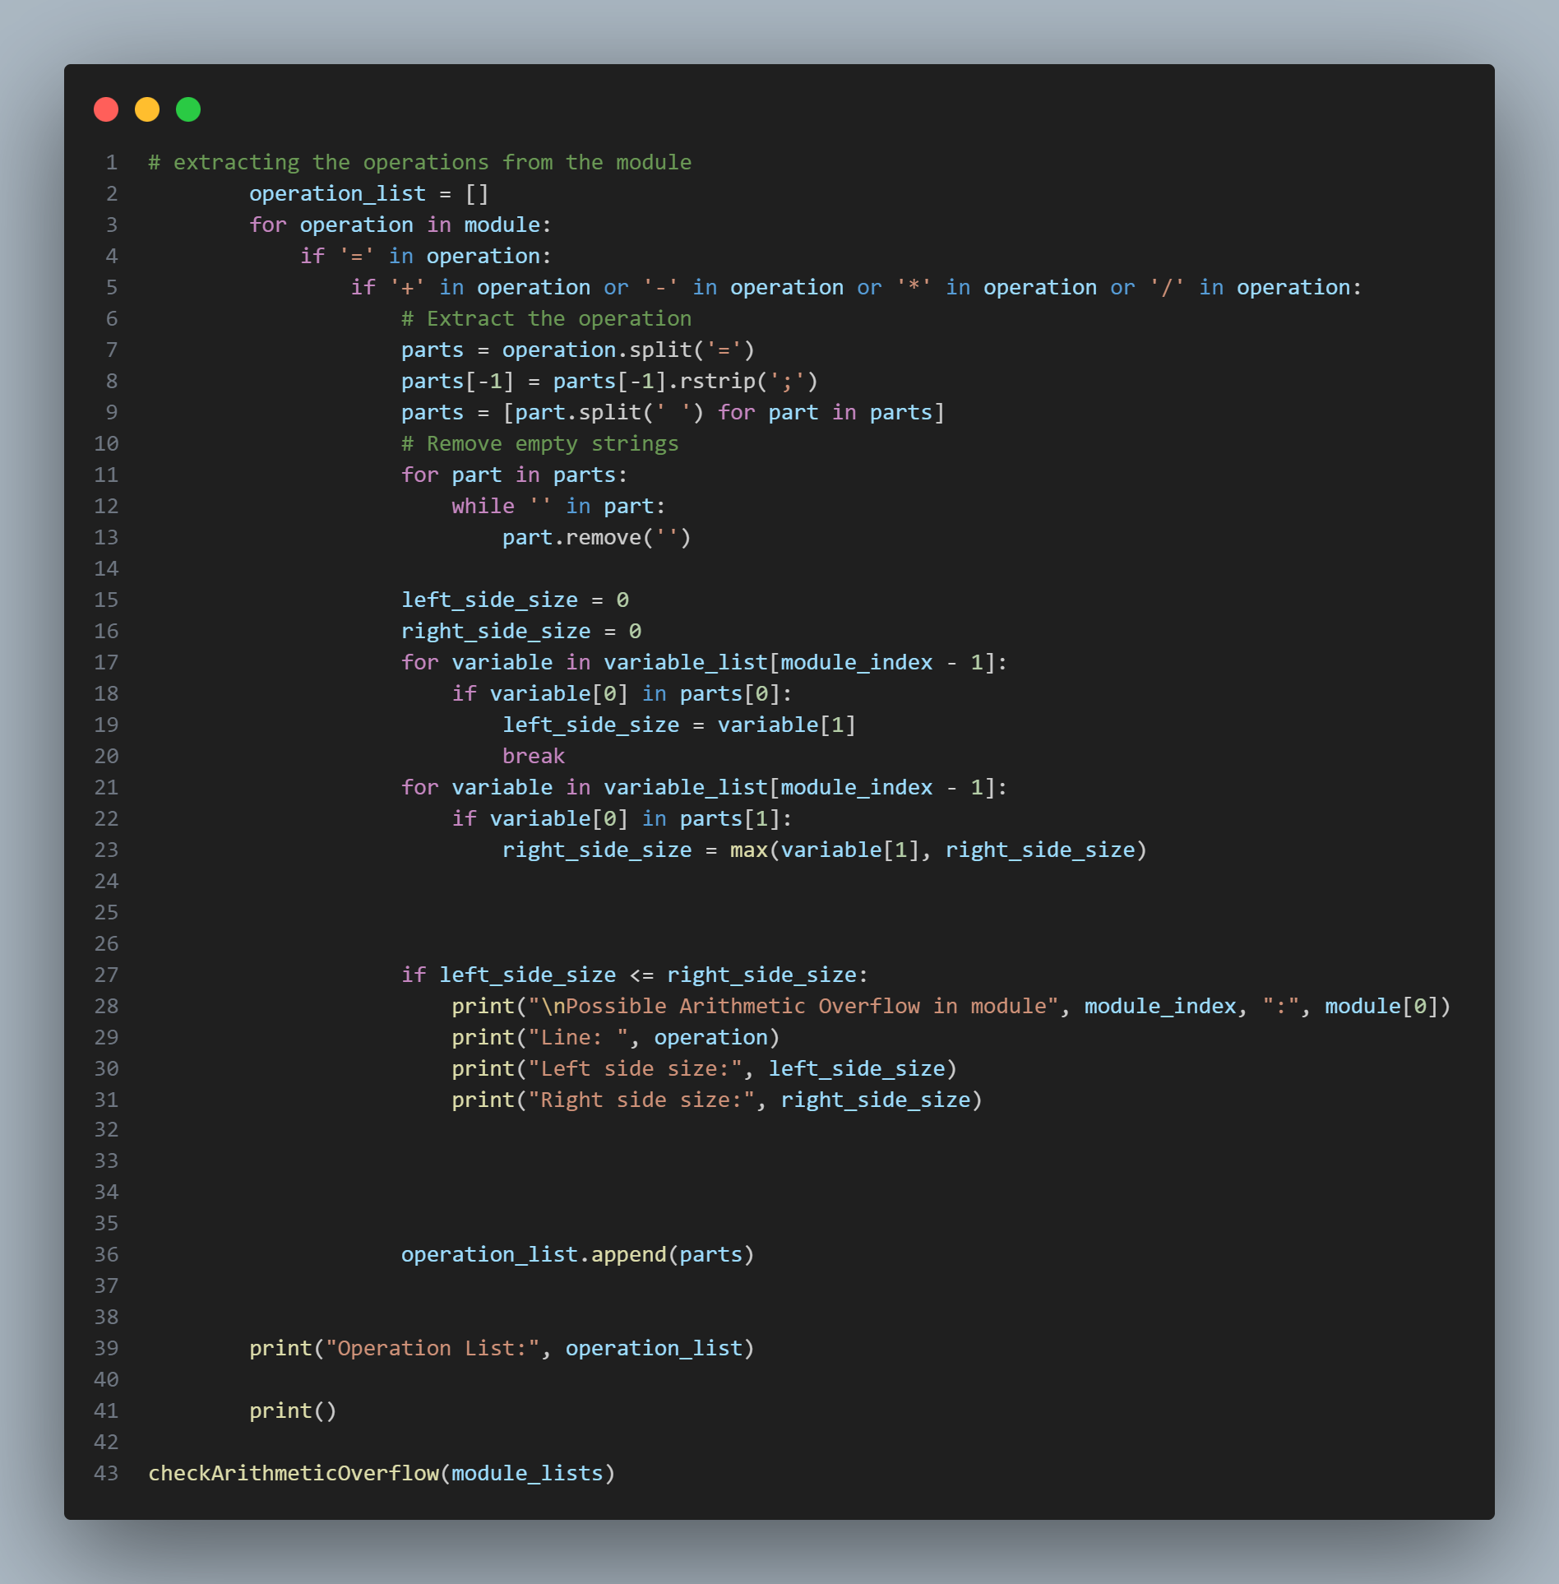
3- Arithmetic Overflow

Slide 22
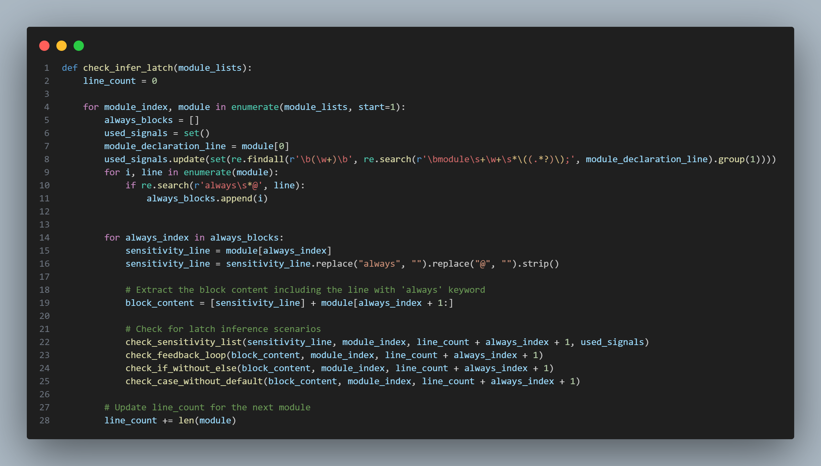
4- Inferring latch

Slide 23
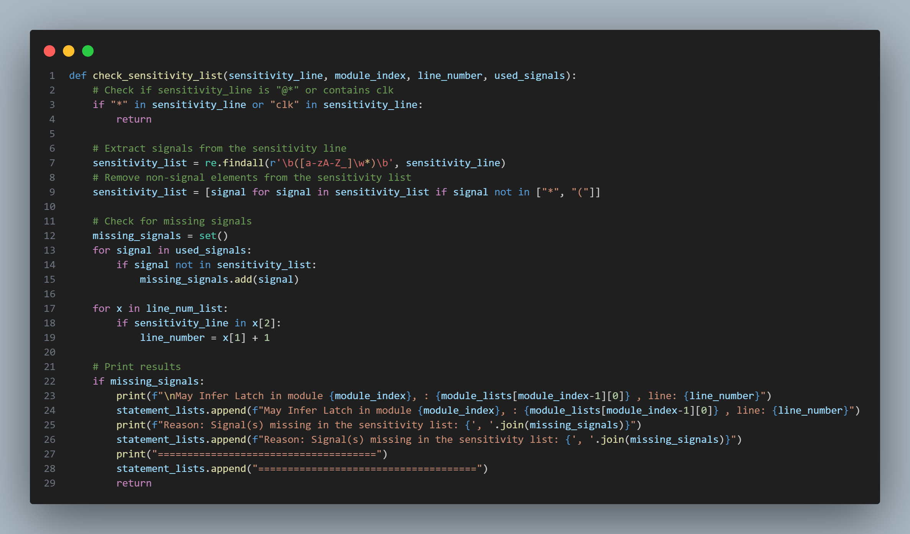
4- Inferring latch

Slide 24
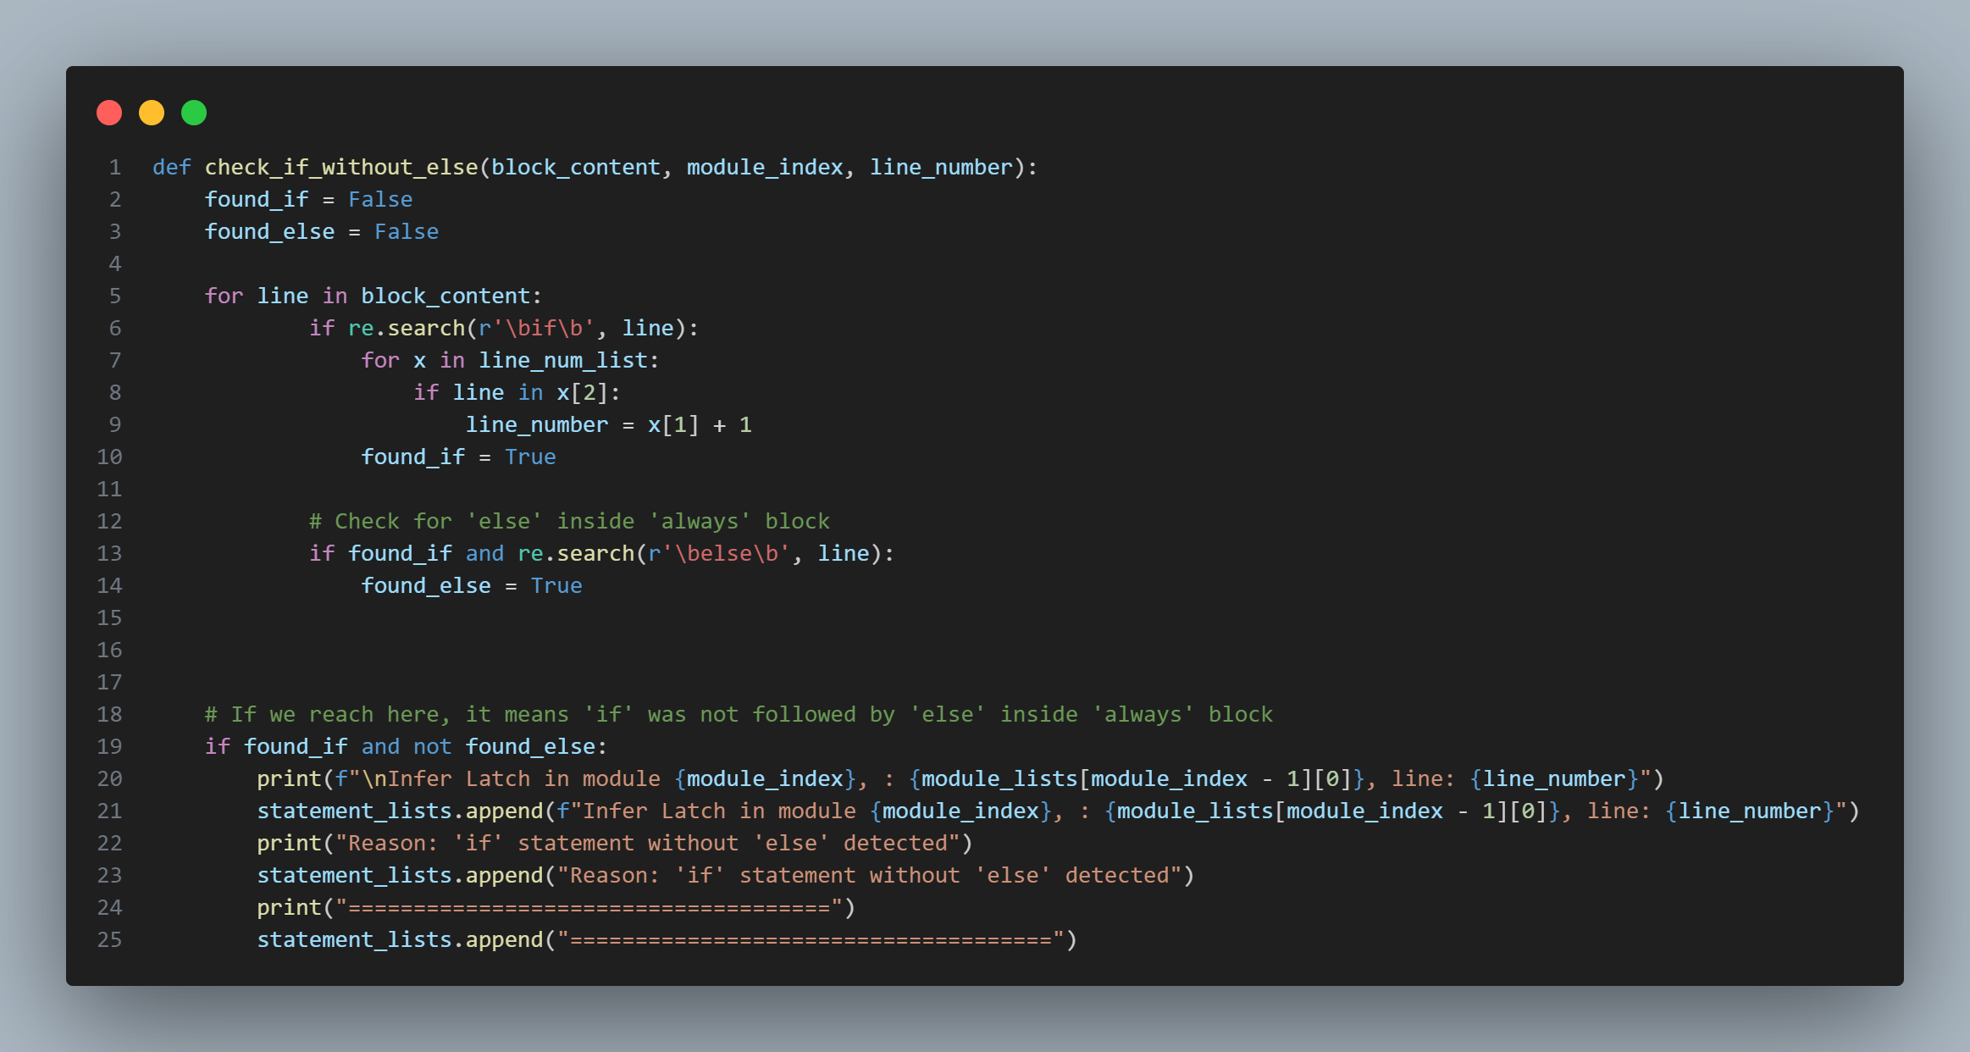
4- Inferring latch

Slide 25
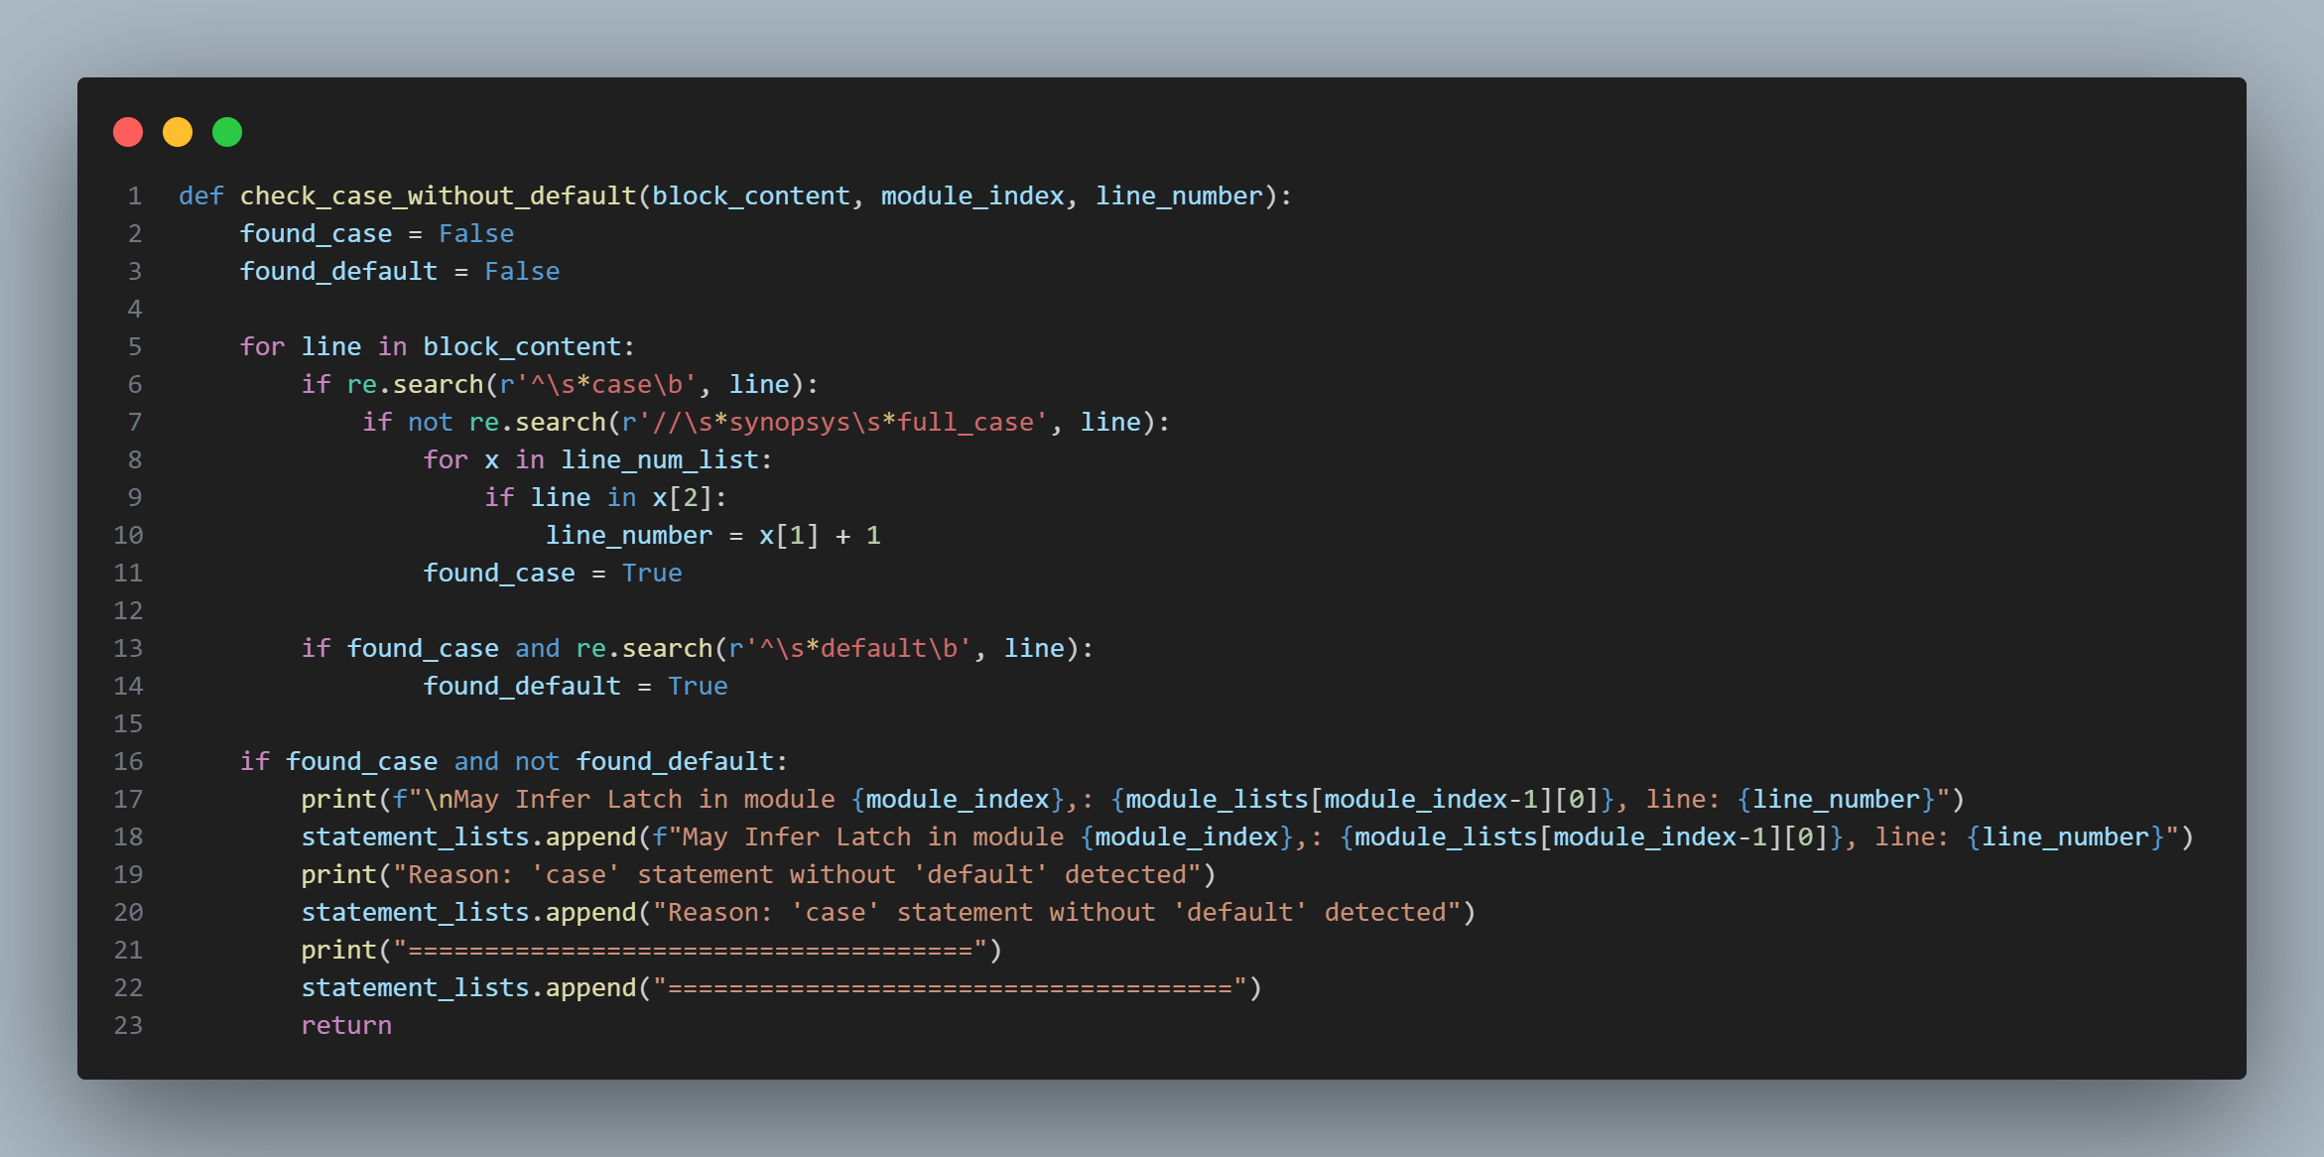
4- Inferring latch

Slide 26
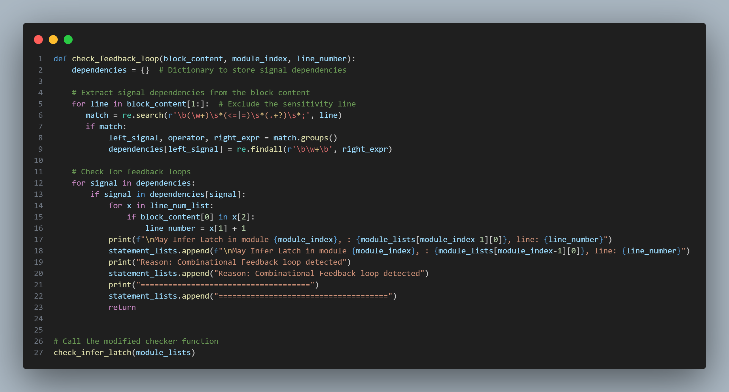
4- Inferring latch

Slide 27
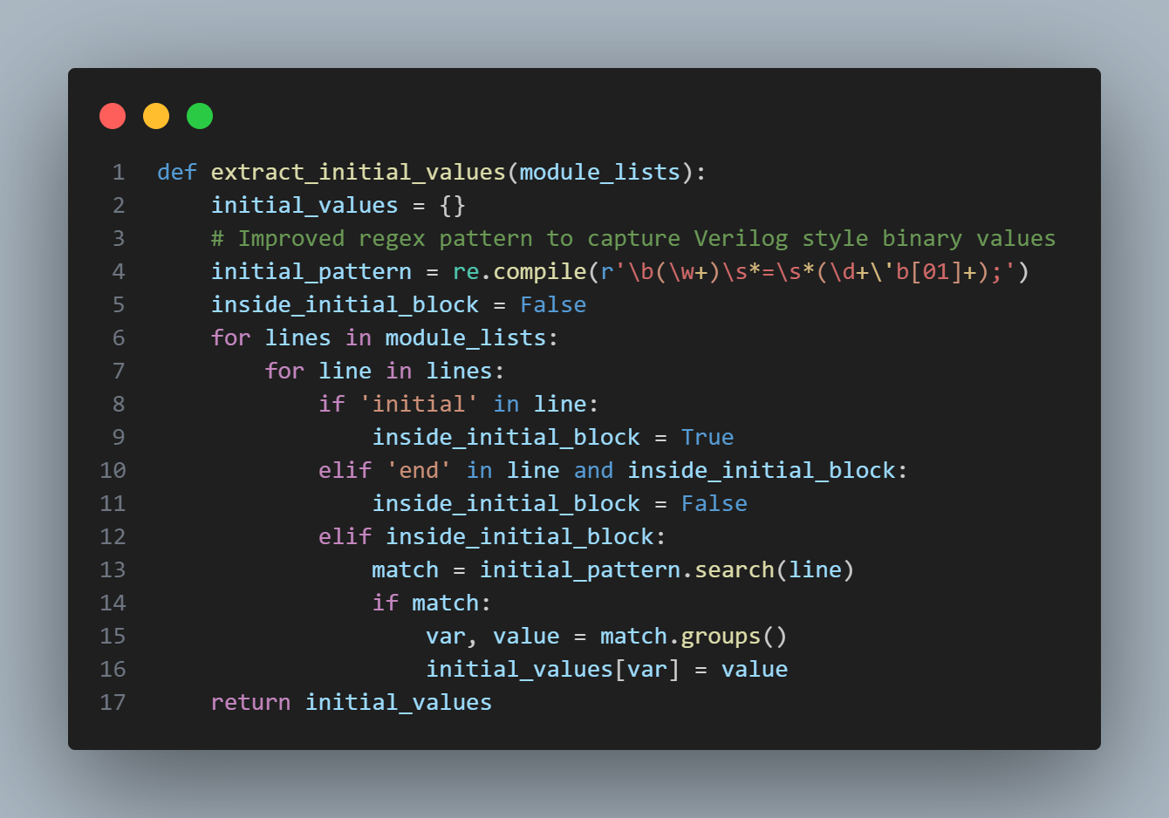
4- Unreachable Block

Slide 28
4- Unreachable Block

Slide 29
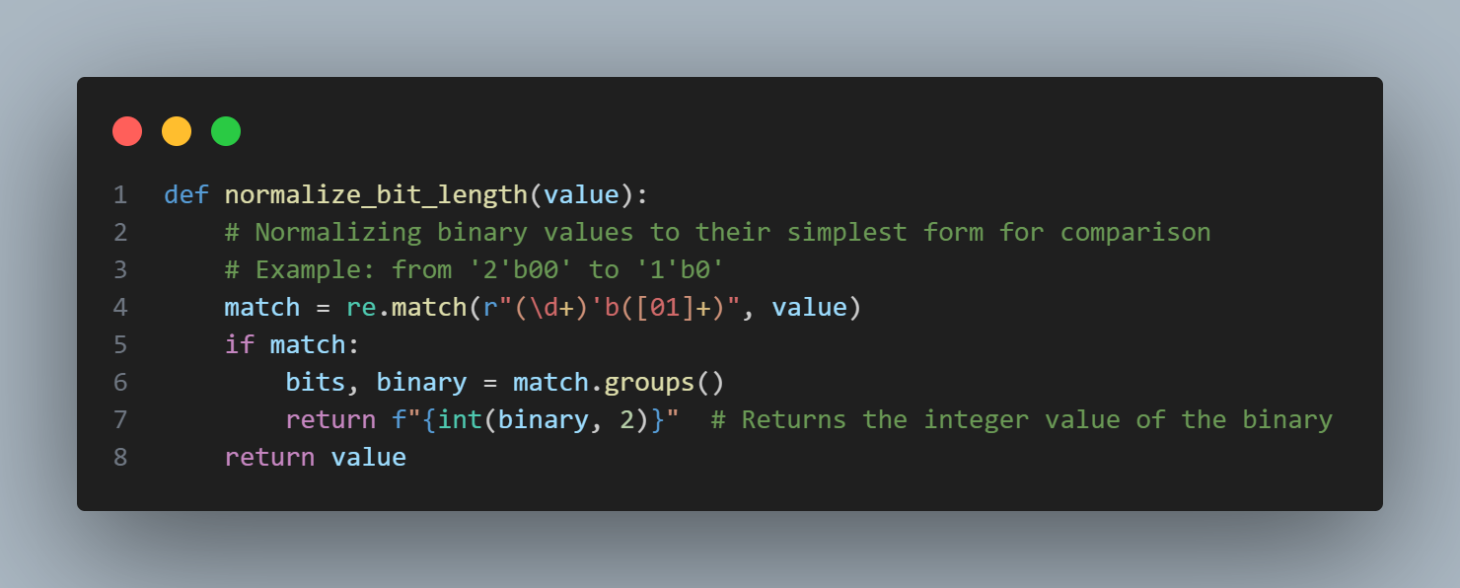
4- Unreachable Block

Slide 30
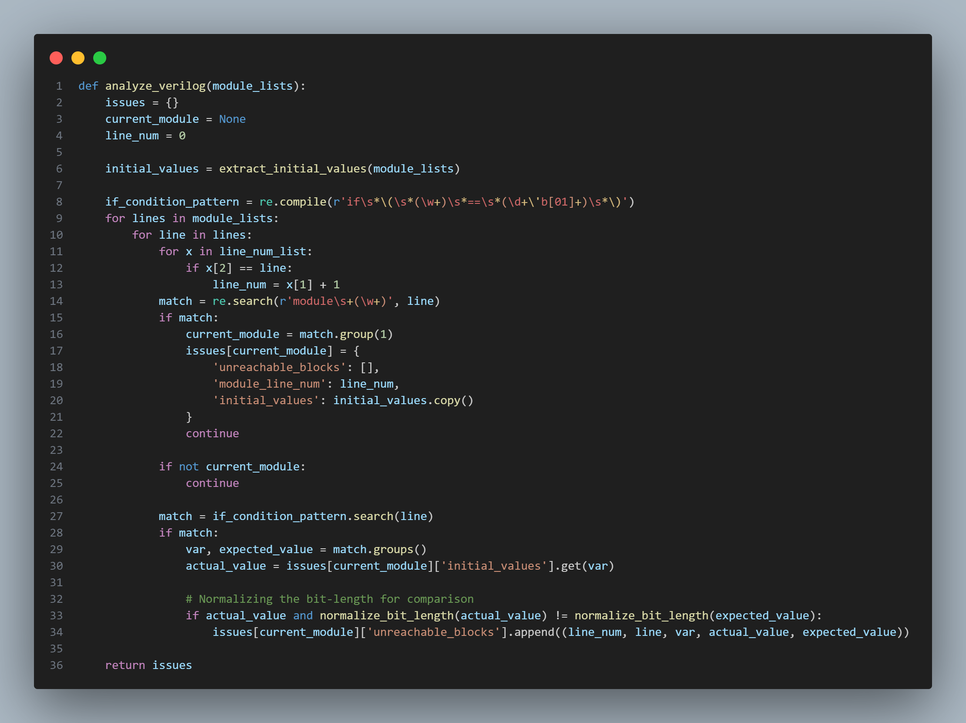
4- Unreachable Block

Slide 31
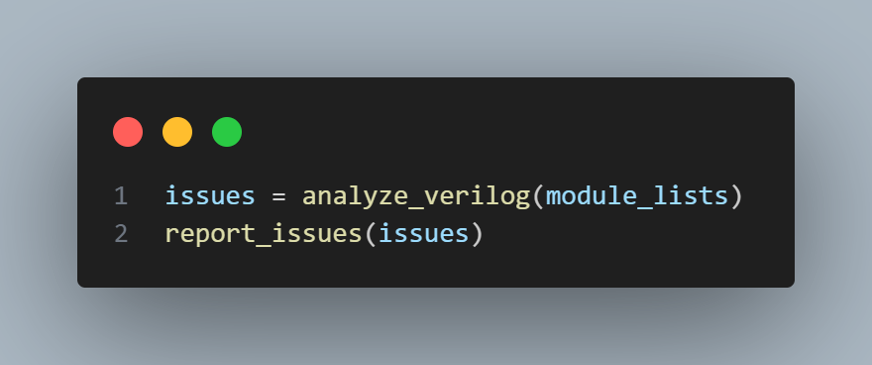
4- Unreachable Block

Slide 32
03
Generated Report

Slide 33
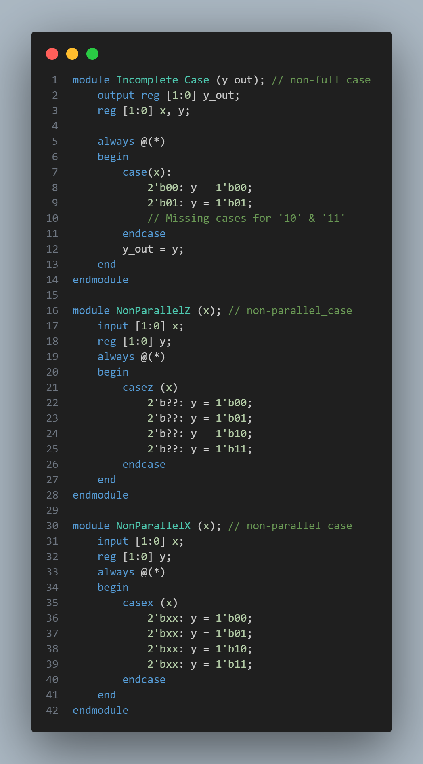
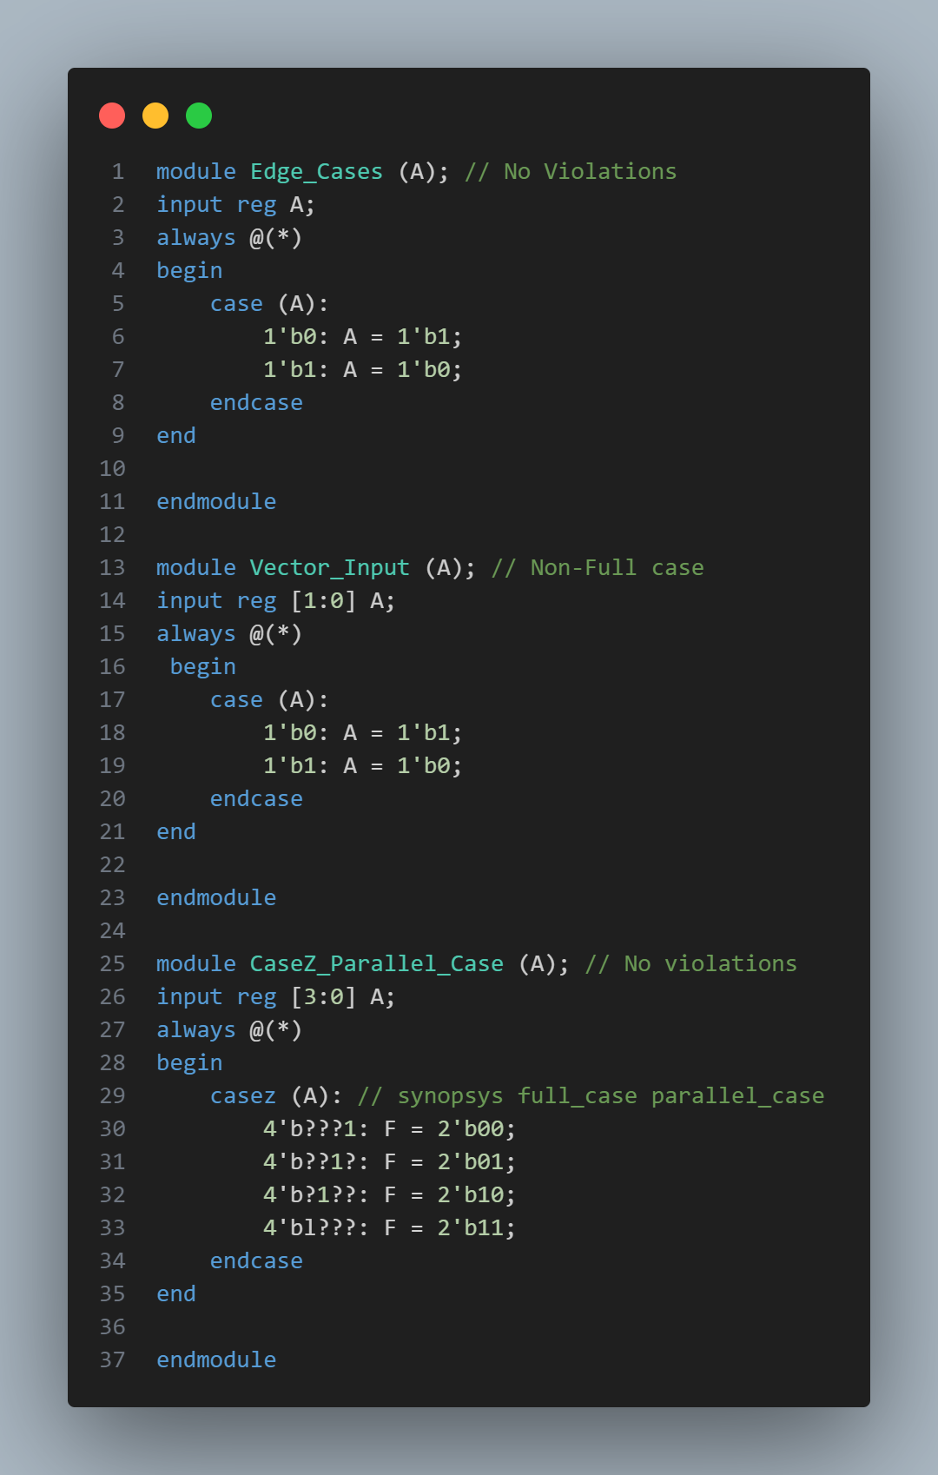
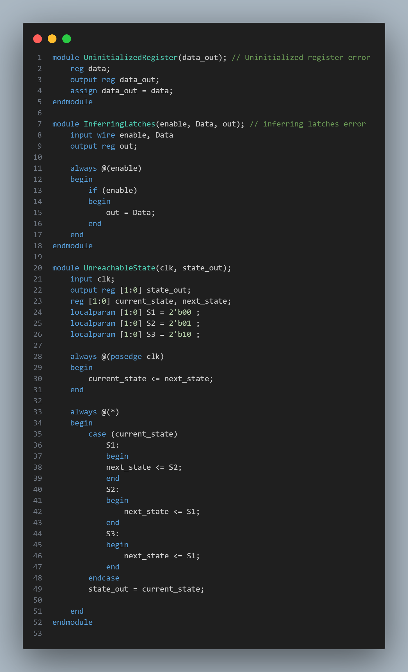
Snippets Of Our DUT: (Full code on lms)

Slide 34

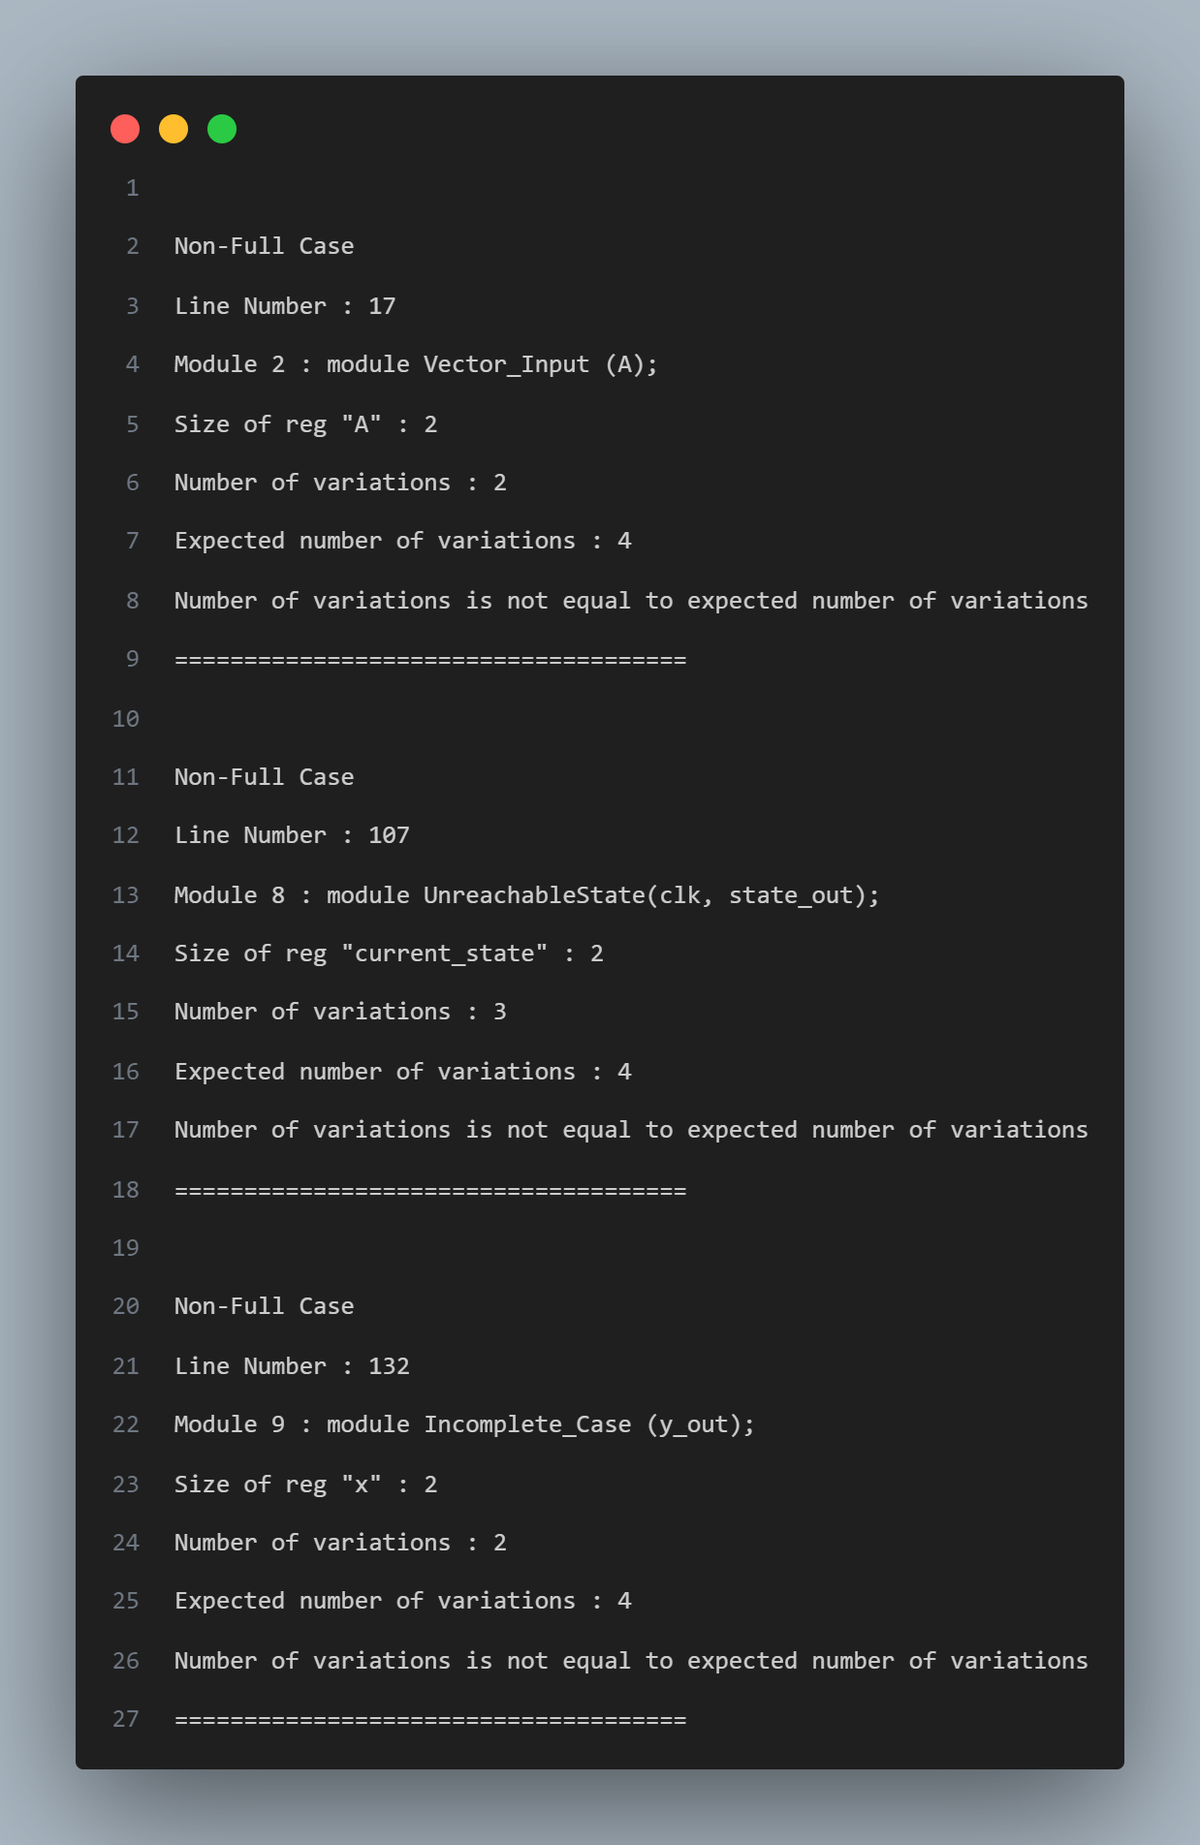
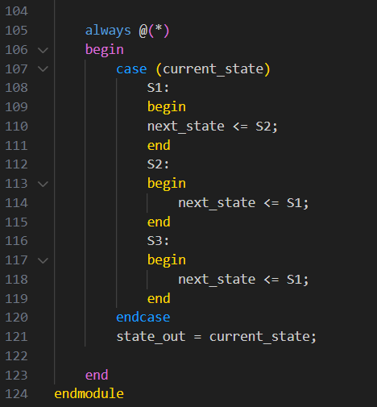
Non-Full Case
Detection
Sample:

Slide 35
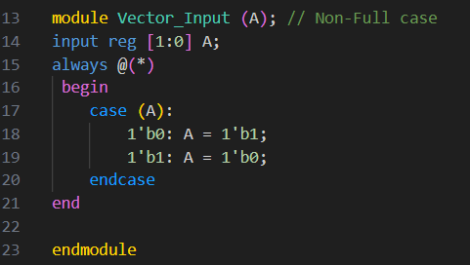
Non-Full Case
Detection
Sample:

Slide 36
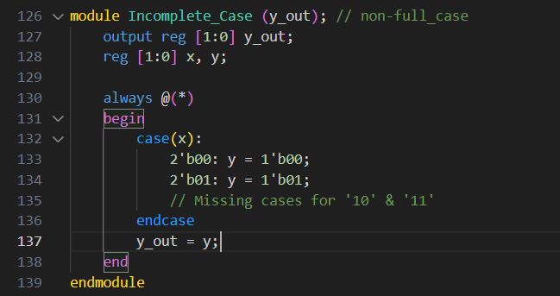
Non-Full Case
Detection
Sample:

Slide 37
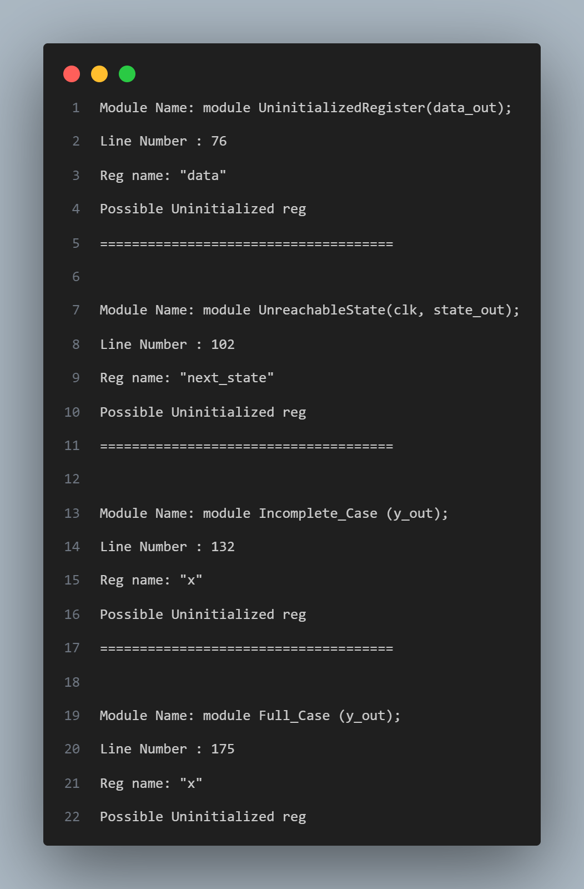
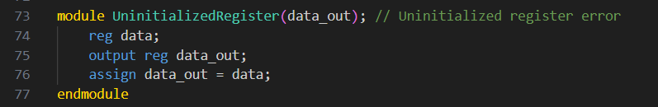
Uninitialized Reg
Detection
Sample:

Slide 38
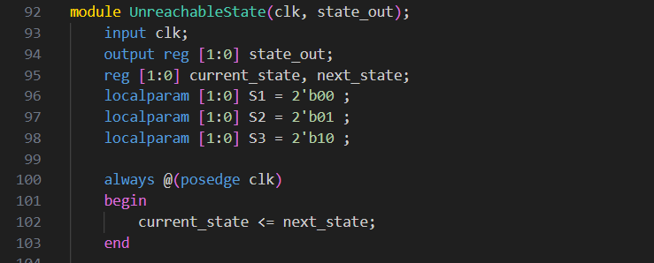
Uninitialized Reg
Detection
Sample:

Slide 39
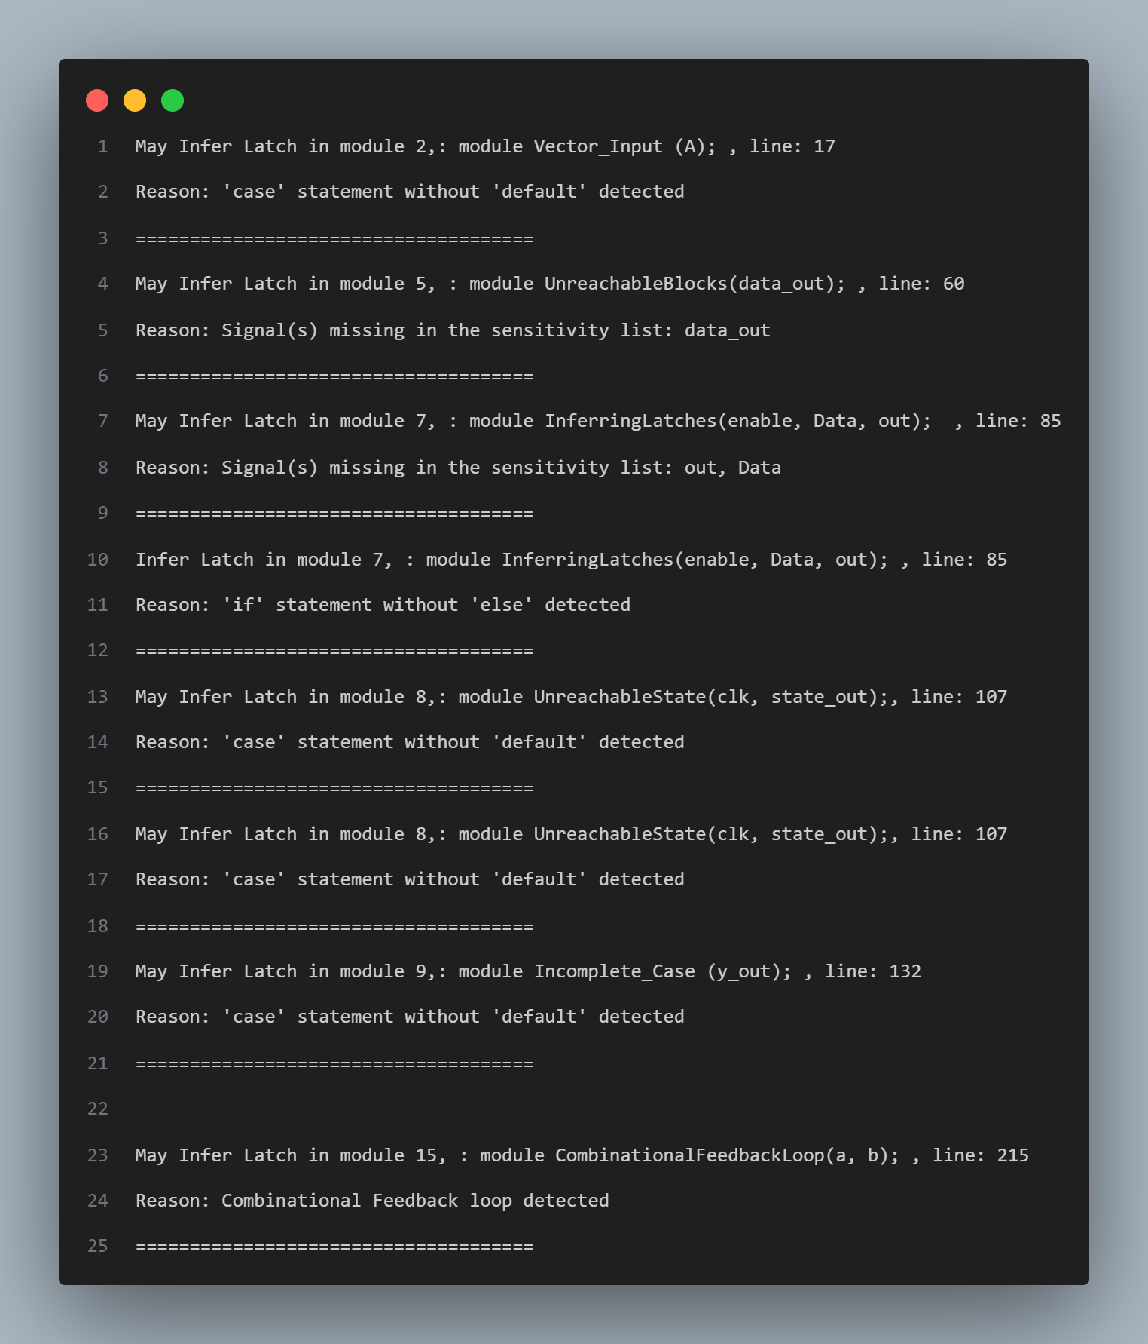
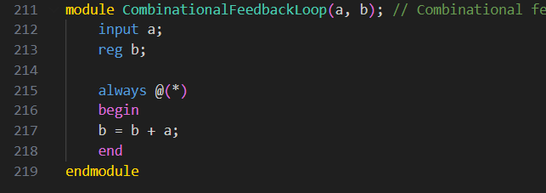
Inferring Latch
Detection
Sample:

Slide 40
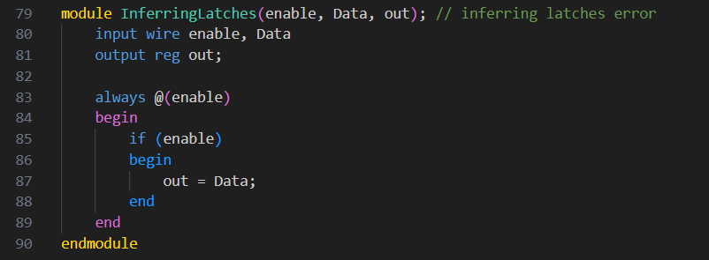
Inferring Latch
Detection
Sample:

Slide 41
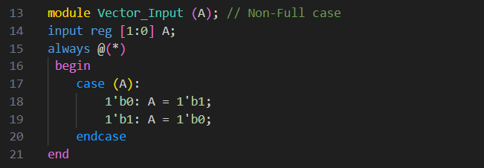
Inferring Latch
Detection
Sample:

Slide 42
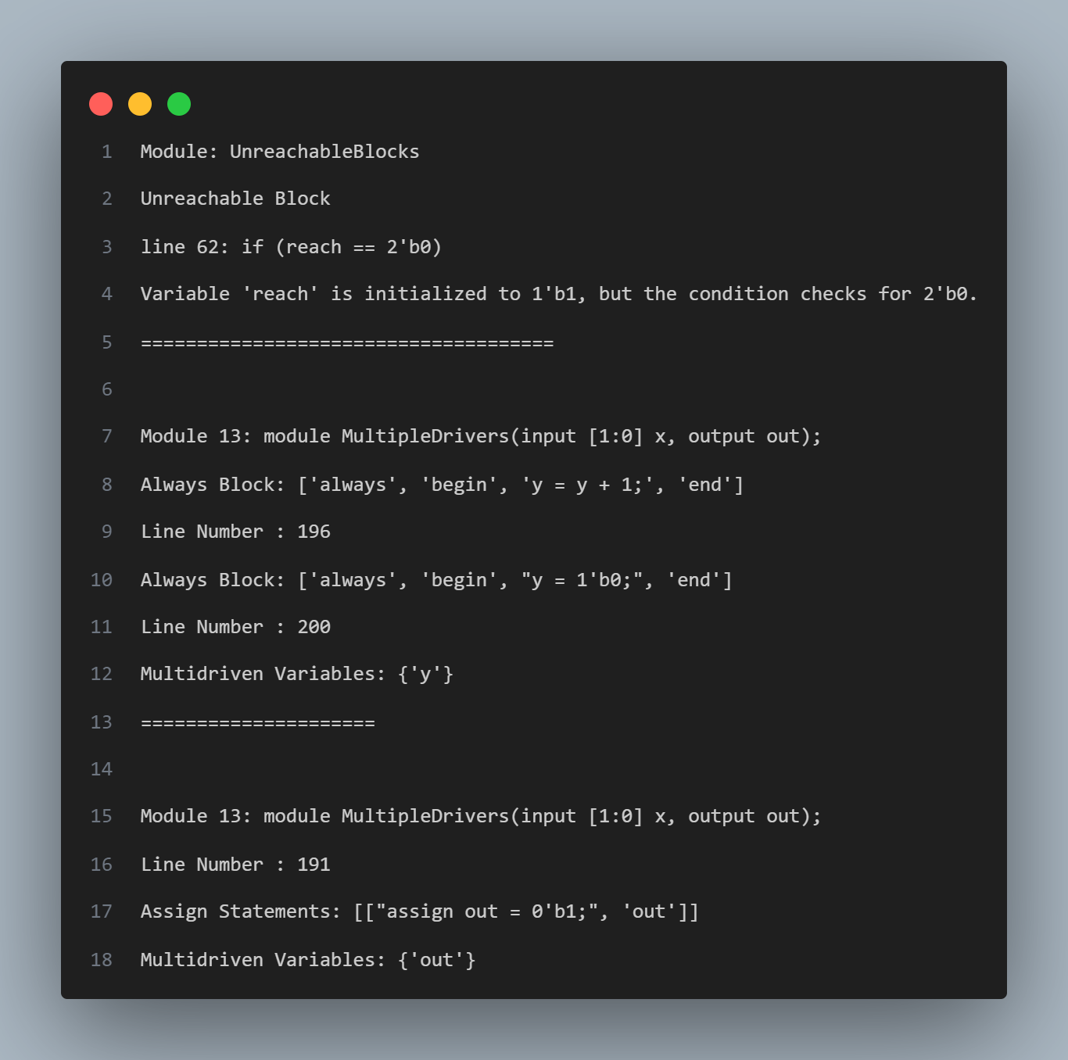
Unreachable block
Detection
+
Multi driven
Variables
Detection

Slide 43
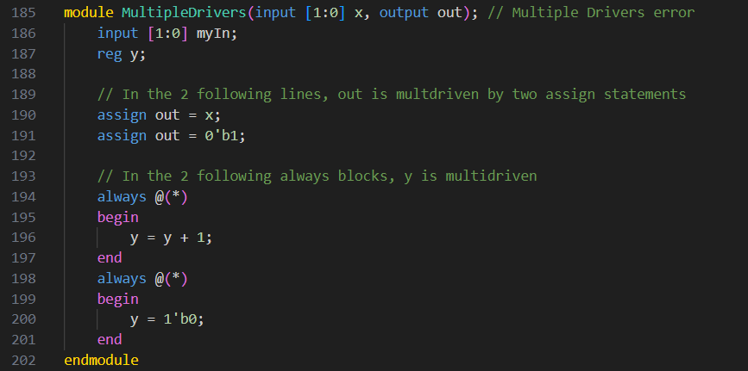
Sample:

Slide 44
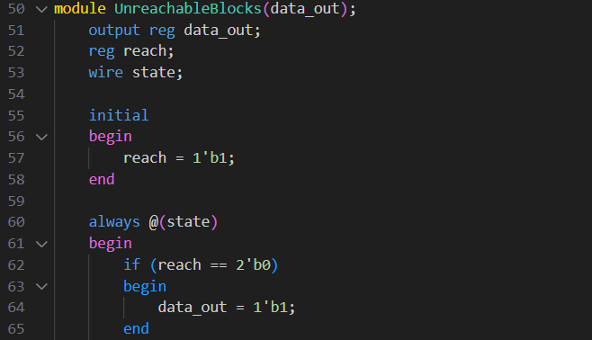
Sample:

Slide 45
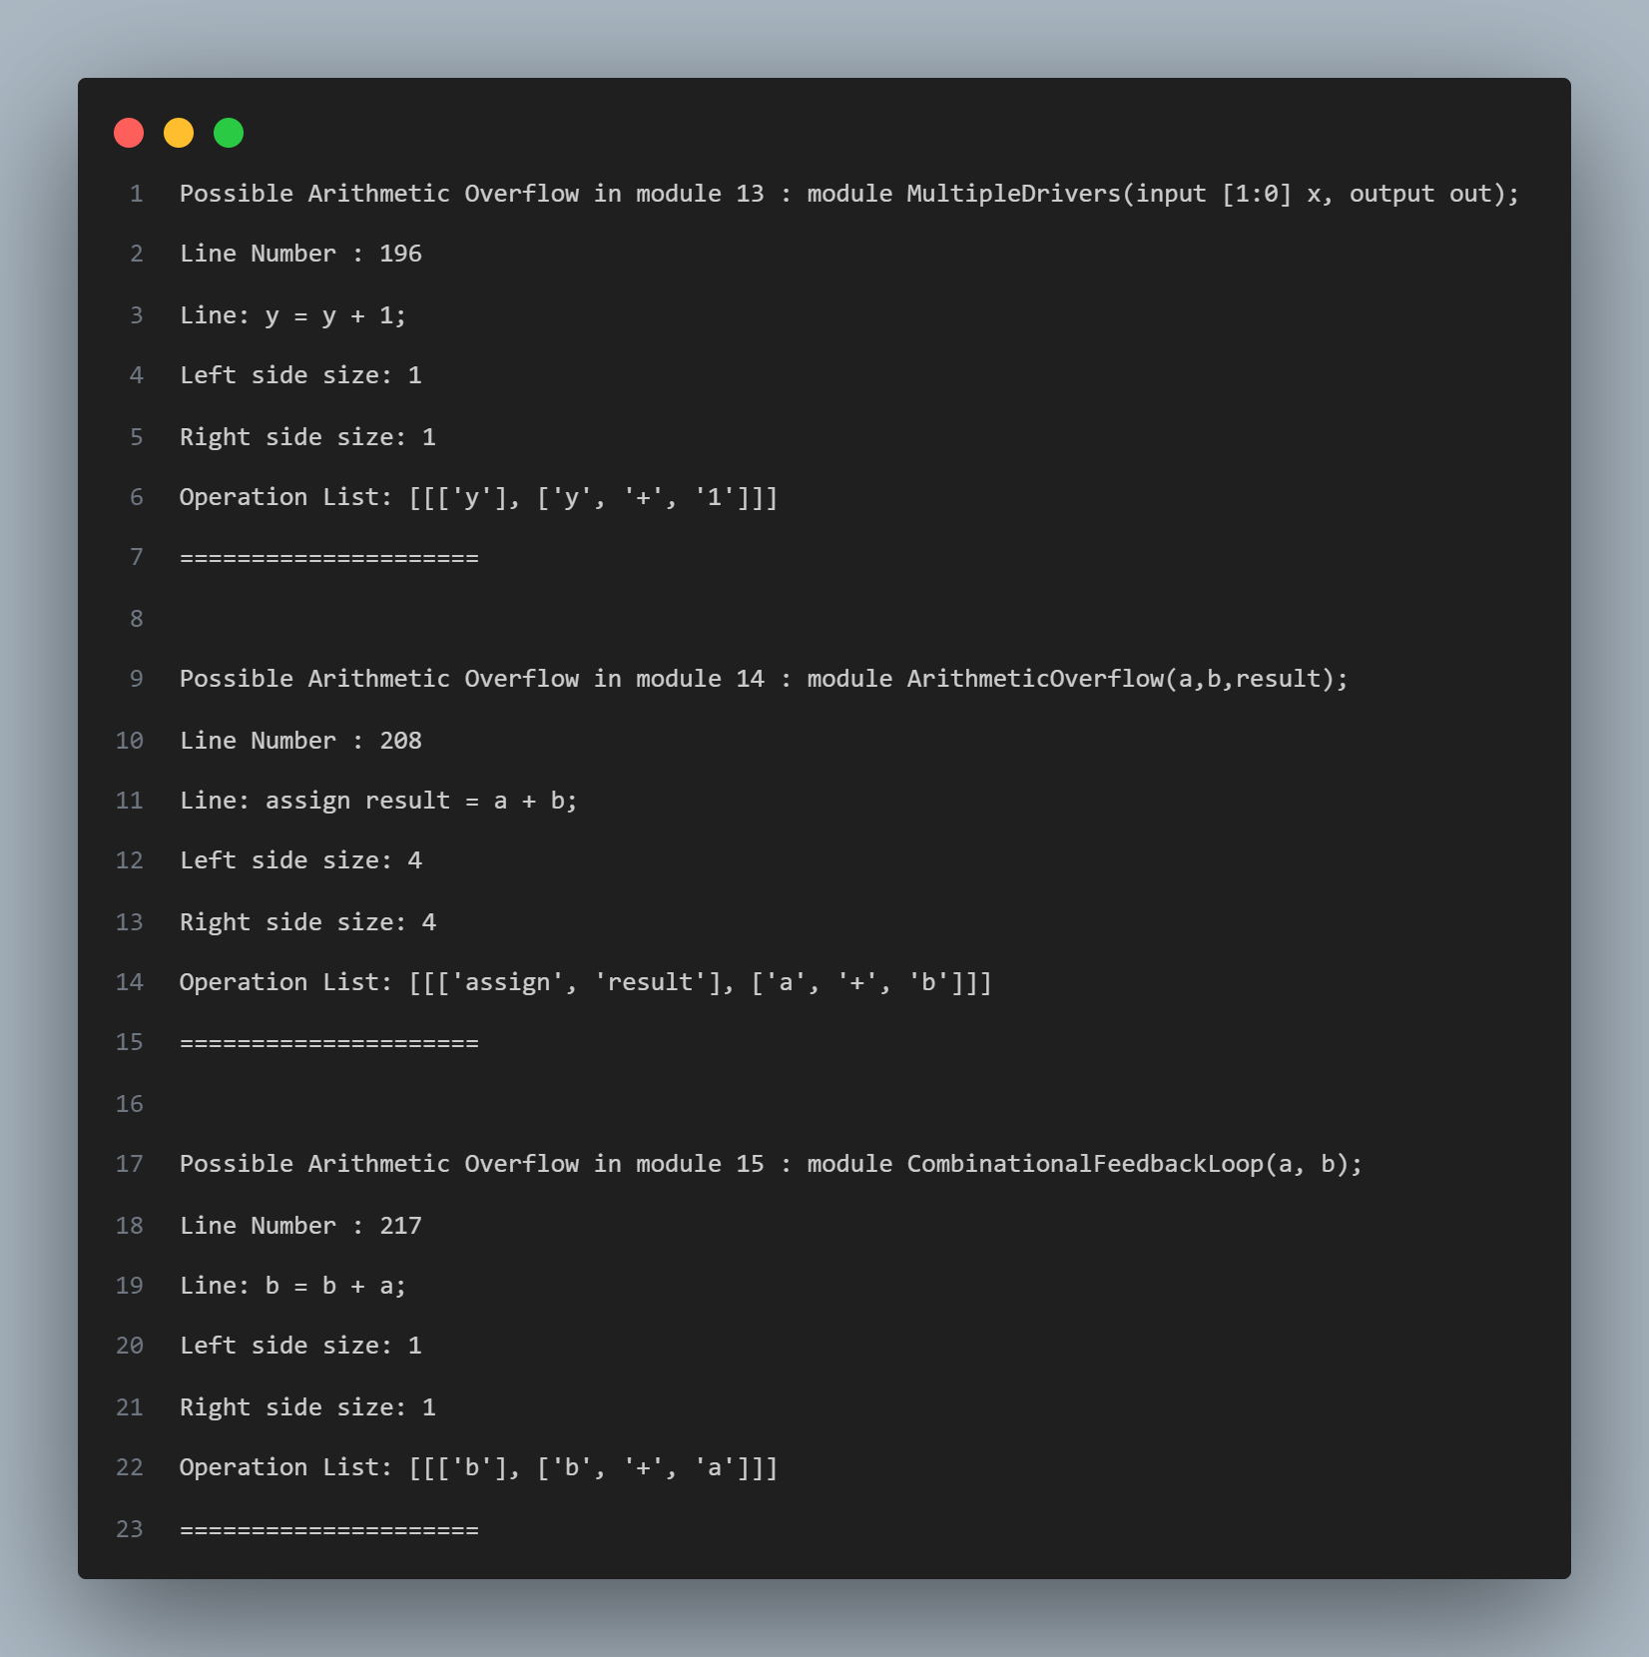
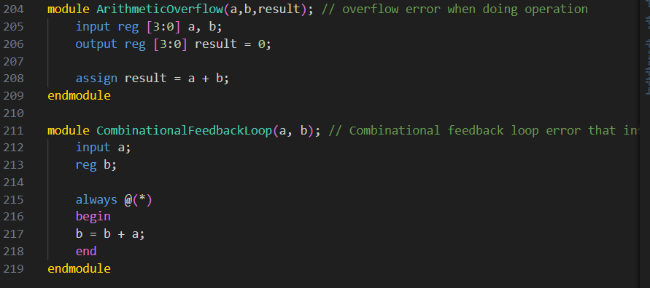
Arithmetic Overflow
Detection
Sample:

Slide 46
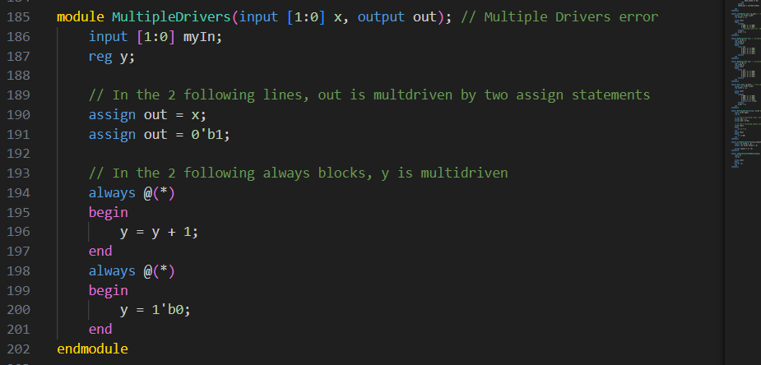
Arithmetic Overflow
Detection
Sample:

Slide 47


Non-Parallel Case
Detection
Sample:

Slide 48

Non-Parallel Case
Detection
Sample:

Slide 49

Non-Parallel Case
Detection
Sample:

Slide 50
THANK YOU

